Slide 1
Nutrition in the prevention of atherosclerosis
MUDr. Dana Maňasková
MUDr. Dana Maňasková

Slide 2
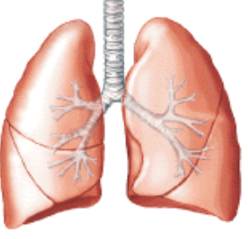
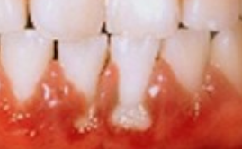
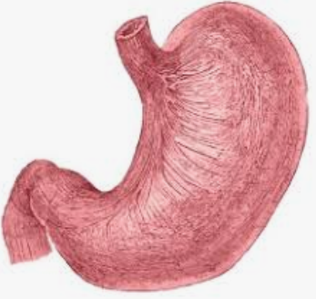
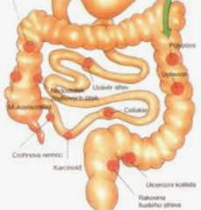
Atherosclerosis
Aterosklerosis is no more seen as a degeneration,
but as slow a chronic inflammation of the endothelium
High blood cholesterol is not the direct causation, but a sign of a body reaction and risc factor (CRP is stronger).
Known suspicious causes of atherosclerosis:
1) Autoimmunity: Chlamydia pneumoniae, Porphyromonas gingivalis,
2) Direct endoth. infection: Chlamydia pneumoniae, Cytomegalovirus
3) Gram negative bacteria toxins (from GIT) - leaky gut syndrome
4) Others: Herpes simplex virus, Hepatitis A virus, Helicobacter pylori
HSP60 - endot.

Slide 3
Aterosclerosis and Chlamydia pneumonia
Chronic infection of endothelium by C. pneumoniae as a mean causal factor of a quick progression of atherosclerosis.
Endothelial infection by C. pneumoniae leads to:
Cytocin production and adhesion molecules expression
Neutrophils a monocytes transendothelial migration
Fat and cholesterol oxidation + other typical changes in Ath.
= Higher cholesterol = consequence of the inflammation !!!
= Crash of today´s therapy and nutrition recommendations !!!
= Higher chance for remission by better targeted therapy !!!

Slide 4
Chron. Inflammation and Cholesterol
Common causes of cholesterol rise:
X liver clearance of cholest., secretion (-vit.C), degradation, (cholesterol oxidation inflammation aj., genetic etc.
+ Absorption from GIT - genetic / nutrition, ...
+ Endogenous synthesis:
Short time regulation - hyperinsulinemia (sugars, insulin resistance = inflamm. - corticoids - stress - low melatonin and many others !!! )
Via TNF alpha, IL-1, IL-6 a IFN-gamma (inflammation)
Other stimuli: unsat.trans-fatty acids, coffee resins, polychlorinated biphenyls, pregnancy...
Cholesterol = consequence of inflammation !!!

Slide 5
C. pneumoniae infection switch to chronicity
10% of community acquired respiratory infections
Risk factors for transition to chronicity = persistent infection
Elevated lung barrier permeability = +migration of immune cells in to the lungs
Other co-infections, asthma, alergie, atophia,
Alfa-1-antitrypsin deficiency,
Nikotinismus, air pollution etc.
= inflammation / readiness to lung oedema / + leak
CAVE: PNC/7 days - persistence development
CAVE: makrolidy, ale jen 3 dny (azithromycin) - risk of resistance !!!
CAVE: “Postinfective asthma bronchiale and corticoid therapy”
Suppression of Th1 response - IFN gamma and killing C.pneumoniae
Infection of macrophages/monocytes in lungs and dissemination into other tissues
Infection of endothelium and slow years to atherosklersis progression
Fatigue continues, cholesterol starts to rise in people with no such problem before
Cold+dry air asthma continues, later artralgia like arthrosis (kenees, C-spine..),...
Seroprevlaence of C. pneumoniae: 60%–70% adults in west countries !!! (1)

Slide 6
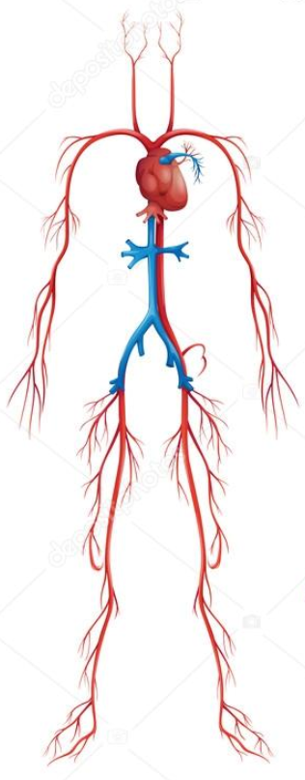
How C. pneumoniae spreads in body
2
Respiratory endothelium, pneumocytes,...
Lung neutrophils - kill + permeability - time !!!
Lung monocytes and macrophages - infected !!
Lung vessel endothelium - blood flow direction
Nearest destinations with high blood flow:
1. Hearth = infarcts
2. Carotides and brain = strokes
3. All others incl.
Atherosclerosis of kidney,
GIT artherias,...
Chronic ischemic disease of the legs
1
3
4

Slide 7
Cure x Chronicity development
Early kill of C.p. in lung alveoli by neutrophils, NO, Th1 response + IFN gamma and cytoxicity
Infection of macrophages in alveoli, vessel endothelia and dissemination to other tissues
Penicillin, Corticoids
Azithromycin and other. effective ATB
Acetylcystein
Echinacea
Betaglucans
Detralex
…aj.
Th2, Th reg. immunity +
Immunosuppression
Leaky lung readiness +
Th1 immunity stimulation, NO killing

Slide 8
Chlamydia pn., Atherosclerosis and ATB rezistence
1997-2009 min. 24 clinical trials (Pubmed) ateroskl.+ATB
Most of trials short time benefit of ATB in patients and stents etc.
Cure and definitiv remission of atherosclerotic process has not been reached even in long time regimen of ATB intake
Infection of endothelium + monocytes
is today considered as
untreatable by ATB monotherapy

Slide 9
Search for C. pneumonia effective treatment
Search of new ATB and combinations with long time
effectivity x C. pneumonia
tissue tolerance without serious side effects
Problems:
Proper lab cultivations and clinical diagnostics
Proper monitoring of successful cure
Short time seronegativity of C. pneumonia (silent persistence in body)
Relapses
Reinfections and further progression
Autoimmunity
part of the progression provoked also by other microbes and conditions
Long time of slow progression (many years)

Slide 10
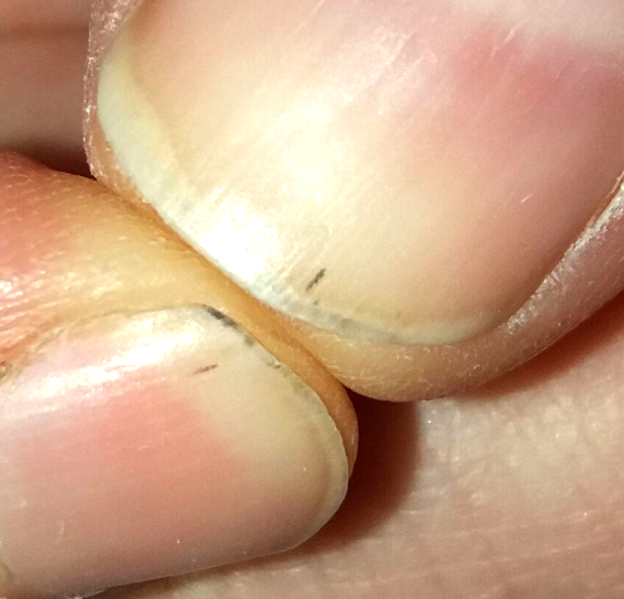
We can count off and only ⅓ of us will be out of the problem
My own casuistic:
15: postinfective asthma br.
18: + cholesterol, esp. + LDL
25: arthralgias: knee,hips,spine
26-37: only C. pneumonia posit.
Repeated Azithromycine teraphy
Asthma and joint pain repeatedly disappears in 1-2 days (long cycles of teraphy)
Side eff.: kill of mitochondrias
Subungual hemorrhagias as early sign of relaps
= atherosclerosis progress
Since 19 years of age “subungual hemorrhages”
(micro-emboli)

Slide 11
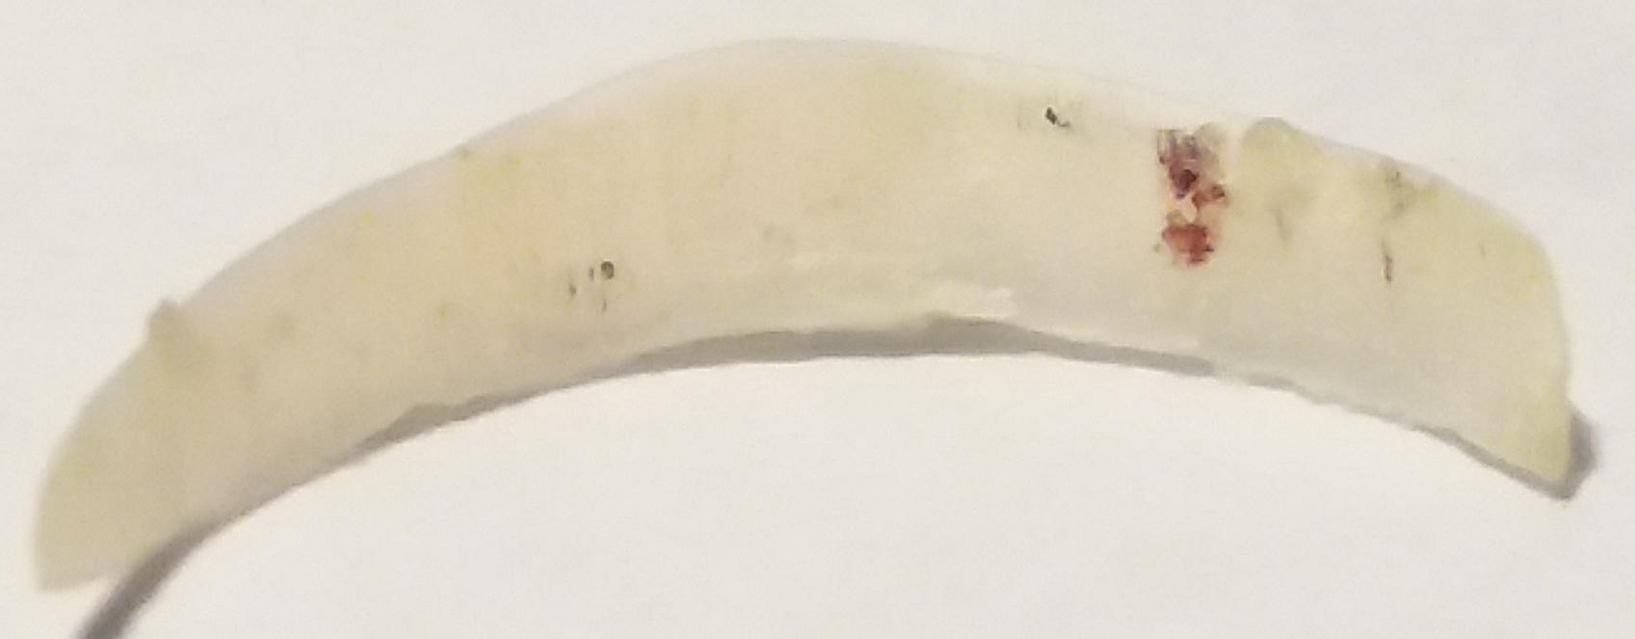
Subungual micro-embolisation
“Chlamydia:platelet ratio of 1:15, adheres to platelets and triggers P-selectin expression after 1 minute and causes an extensive aggregation and ATP secretion after 20 minutes of incubation. Other tested bacteria had no or only moderate effects on platelet functions.”
PMID: 12842841 OI: 10.1161/01.ATV.0000084810.52464.D5

Slide 12
Supression/kill of C. pneumonia
Progression of C. pneum.
ATB in pills:
Macrolides, tetracyclines, new types
mucolyticum: Acetylcystein
Natural ATB in food - PLANTS
Immunomodulancia
Th1 immunity +, NO, IFN gamma
Antioxidants
Probiotic bacterias
Sleep (melatonin)
Serotonin
Immunosupresive ther., cytostatics
Corticoids (pills, stress, other infections, sleep disorders, depressions, Inflammations, oxidative stress...)
Homocystein + (deficit B6, B12, B9)
Hyperglycemia, AEGs,
Tryptophan
Na+
Autoimmunity
Inflammation
Infection
Oxidation stress
CAVE: Effective therapy = lysis of infected cells, released Ag = ++ inflammation

Slide 13
Today ter. of aterosclerosis and C. pneumonia
Surprise: Proof of different ways of inhibition of C. pneumonia in medication
Antiplatelet medication: aspirin, clopidogrel (Inhibited formation of chlamydial inclusions and proliferation, caused depletion of essential growth factors of C.p. - effect had been blocked by addition of tryptophan)
COX 2 inhibitors : short time supresion of C.p. infectivity and growth
Statins: lovastatin (2), simvastatin (lowered counts of viable C.p., inflammatory infiltration in lugn tissue, in acute infection lowered proinfalmmatory antichlamydial activity, blocked Akt phosphorylation stimulated by C. pneumonia – and by this also migration of endothelial cells),
fluvastatin (blocked scavenger receptor LOX-1 which limited entry of oxLDL into endothelial cells infected by C.p.)

Slide 14
Beta-blockers: bisoprolol, metoprolol (wake-up C.p. from persistence to productive infection – synergis effect with ATB therapy and antichlamydial effect of some natural phytochemicals
ACEI: perindopril (2), enalapril (2), ramipril (inhibit matrix metalloproteinases activated by C. pneumonia)
AT blokátory: valsartan (2), losartan (lowered risk of Chlamydia trachomatis infection), olmesartan (2)
Antikoagulancia: enoxaparin, heparin (Inhibit adhesion of elementary body of C. trachomatis and C.pneumoniae on cell surface and so it´s infectiveness) (2)
Inhibitors of glycoprotein IIB/IIIA: tirofiban, eptifibatide (2), abciximab (Chlamydia adheres to platelets and triggers P-selectin expression after 1 minute and causes an extensive aggregation. Inhibition of IIb/IIIa by abciximab strongly reduced this platelet aggregation.)

Slide 15
Vazodilatancia: isosorbid dinitrate (2, 3), isosorbid mononitrate, nitroglycerin (donors of NO - elevating its concentrations, NO kills C.p.) (3)
Diuretics: amilorid, chlorthiazide (2, 3) – (disturbs Na+ cyclus of C.p. in membrane, dimethyl amiloride inhibits macropinocytosis in dendritic cells and macrophages in bone marrow - lowered amount of chlamydial internalisation into the cell cca to 75-67%) (4)
Calcium channels blockers: synergic effect with ATB and some natural phytochemicals against C.p., verapamil (inhibits growth and maturation of C. pneumonia and so it´s infectivity), amlodipin (2)
Immunosuppressants: (part of some stents): rapamycin (inhibits infectivity of C.p. by suppression of maturation of elementary bodies by several mechanisms) (2)
Venotonics: hesperidin, rutin (lowers leukocyte entry in the tissues, vessel leakage, inflammations and effectively regenerates resveratrol, which is effective against C.p.)
Niacin and nicotinic acid (lowers cholesterol) – works against C.p. (3)
Acetylcysteine and similar molecules (disrupts surface membrane of elementary body C.p. and other microbes incl. disruption of microbial films, lowers homocysteine, elevates glutathione) (3) aj...

Slide 16
C. pneumonia, phytochemicals and atherosclerosis
Resveratrol
In infected monocytes C. pneumonia blocks proteincinase C and NOX and by this the production of ROS, oxidated LDL and so amount of foam cells. In vitro suppressed division of C. pneumonia. Significant synergia with clarythromycin and ofloxacin (inhibits cellular efflux pumps)
2006 (5) and 2016 (1) published 2 extensive in vitro study and prooved antichlamydial effects of many phytochemicals - many of them highly effective !!!
Nutrition and food supplements directed against C.pneumonia:
+ Effectivity of ATB therapy of respiratory infections
- Risk of chronic infection development
+ Chance to lower or stop the progression of atherosclerosis and many other associated diseases !!!

Slide 17
Chemicals with prooved effectivity x C. pneumonia
Methoxy psoralen-Bergapten
Scopoletin
Methoxsalen - xanthotoxin
Acacetin
Apigenin (žlutý pigm.)
Morin
Myricetin
Quercetin
Luteolin (žlutý pigm.)
Dodecyl galát
Methyl galát
Octyl galát
Propyl galát
Epikatechin galate
Rhamnetin
Cystein
Baikalin
Berberine
Betulin
Biochanin A
Caffeic acid
Lauric acid (coconut)
Capric acid
Monocaprin
Melatonin
Serotonin
Mycophenolic acid
NO
Rhamnetin
Scopoletin
Schisandrin B, C
Zoledronic acid
Probiotika - produkce NO:
Enterococcus faecium,
Laktobacily:
L. brevis,
L. salivarius,
L. gasseri,
L. jensenii,
L. vaginalis,
L. crispatus
More I collect here: http://medicinman.cz/?p=nemoci-sympt/chlamydie/anti-infecni-vlivy

Slide 18
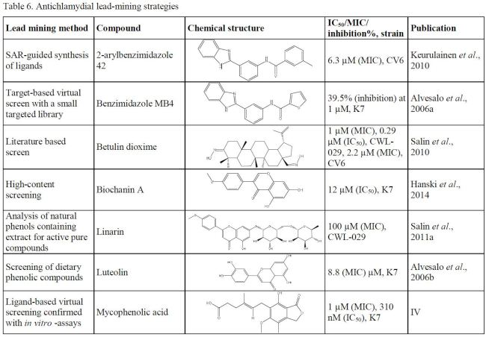
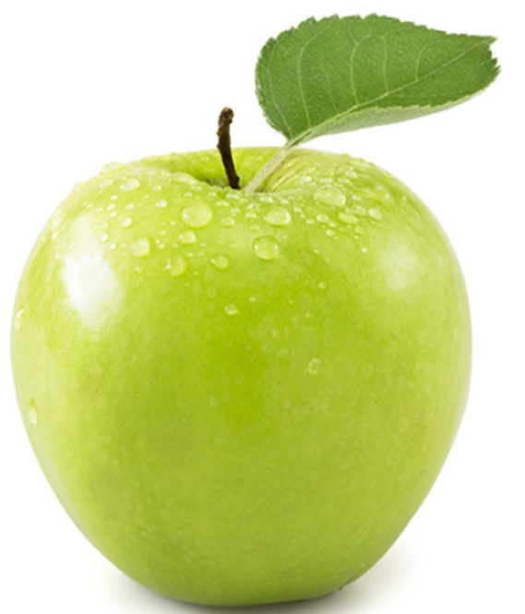
Most potent natural antibiotics
In vitro

Slide 19
Antiatherosklerotic / C.p. suppressing food-list:
Breakfast, lunch, dinner - combinations of mean sources:
Proteins: sunflower seeds, lentils (fazol obecná, mungo výhonky, sojové výhonky), jogurts and kefirs, Roquefort cheese,...
Vegetable: petsilia, broccoli, sweet paprika, cabbage sorts, celery stalks, parsnip, chicory salate, artichoke, lilac, pea, onion sorts, carrot, pumpkin, salat chrysanthema, sorrel, cauliflower, kohlrabi, radish sorts, dandelion, nettle, okra, momordica indochinese (Charantia), moringa oleic, sesame sprouts, spinach,...
Starch: maniok a flour of it, amarant
Saccharides / fruits: citruses (grep, kumquat, citron aj.), strawberry, mulberry white and black, Averrhoa bilimbi, guave, goji, apple, grape - seeds, blue berry, raspberry, schizandra fruit...

Slide 20
Fats: olive oil, coconut oil, oregano oil, cannabis oil,...
Herbs and spices: cinnamon, gree hay, agastache, menta sorts, moringa, propolis, satureja, valeriana, Lpida citriodora, garlic,lemon grass, chili green and red, caltrop, neem leaves, pepper, sweet paprika, curcuma, chinese garlic, coriandr, Cowpea,Tropaeolum majus, Brassica napus, rosemary, slavia, tyme, oregano, celery seeds, juniper fruit, basil, melisse, liquorice, St. John´s wort, cannabis, aceito,
Drinks: dandelion coffee, hop - beer, chamomile tea, green tea, curcuma dring, mentha tea, jung barley, red vine, lapacho tea,...
Supplements: noni, ginkgo biloba, niacin - vit. B3, beta glucans, echinacea, resveratrol + rutin/disominol/aescin, Chamomilla Teva / Ivax, red clover, caltrop, vitamin D, lotos powder, schisandra chinensis, cordiceps, bergamot oil, vitamin A, chondroitin sulphate
Living style: sleep (melatonin), optimismus (serotonin), sun (vit. D), sport (lactic acid, NO, +immunity), low homocysteine (B6, B12, B9)..., low salt, no smoking, cold exposure, endurance activity, low carb food, breathing exercises

Slide 21
2019: http://www.polygenicpathways.co.uk/chlamydia.htm
Metabolic screening of Chlamydia pneumonia
Cholesterol
C. pneumoniae modifies cholesterol homoeostasis in macrophages via JNK-PPARG dependent pathways (Liu et al, 2010 ) [153] + ways of foam cell formation !!
Entry into epithelial cell lines is cholesterol dependent [153] = + membrane cholesterol = easier cell infection (brain !!!)
Blocked by nystatin or filipin (Korhonen et al, 2011) [153]

Slide 22
Glutamate, glutamine and aspartate
Stimulated C. pneumoniae growth more than C. trachomatis (Al-Younes et al, 2006) [153]
Glycolysis
Host glycolysis enhances bact. growth in hypoxic conditions
Abrogated chlamydial progeny by RNA silencing of:
Phosphofructokinase (PFKP)
Lactate dehydrogenase (LDHA)
Glycerol-3-phosphate dehydrogenase (GPD2)
Forkhead box O3 (FOXO3) (Szaszák et al, 2013) [153]

Slide 23
Heparan sulphate
C. pneumoniae OmcB is an adhesin that binds heparan sulphate-like glycosaminoglycans (Moelleken and Hegemann, 2008) [153]
Phenylalanine
Is being used by C.p.
S-adenosylmethionine (SAM)
Chlamydia lacks enzyme necessary for SAM synthesis and scavenge it from the host via a specific transporter (Binet et al, 2011) [153]
Arginin
Chlamydiae import arginine from the host (Smith and Graham, 2008) [153]

Slide 24
Tryptophan and valine
Marginally inhibited C. trachomatis growth
Enhance C. pneumoniae growth [153]
Tryptophan
Essential amino acid for chlamydiae
Intracellular growth regulates indoleamine 2,3-dioxygenase
Cleaves l-tryptophan [56]
IFN-gamma produced by T lymphocytes and natural killer cells regulates the synthesis of IDO, catabolizing tryptophan to its two metabolites = Tryptophan depletion by IFN-gamma = most important host defence system
When tryptophan levels are depleted, C. p. growth is arrested.
Addition of excess tryptophan restores replication

Slide 25
Aromatic amino acid hydrolase, Cpn1046
Uses the hosts' phenylalanine, tyrosine, and tryptophan
Converting them to:
Tyrosine (precursor of tyroideal hormons), dihydroxyphenylalanine, and 5-hydroxytryptophan (5-HTP precursor of melatonin, serotonin) (Abromaitis et al, 2009) [153]
Iron
Growth of C. pneumoniae in a human Hep-2 cells strongly inhibited by: iron restriction / iron-chelatators [14]
Infected endothel C.p. + Iron = upregulation:
VCAM-1 (vascular cell adhesion molecule-1) expression
ICAM-1 (intercellular adhesion molecule-1) expression [14]
Enhance atherogenesis in C.p. infected [14]

Slide 26
Nicotine
stimulated chlamydial growth via cholinergic receptors in hepG2 cells, which contain these subunits (Yamaguchi et al, 2003) [153]
Tyrosine
Used by C.p.
Hypoxia
growth of C. pneumoniae enhanced in a low 02
role of the mitochondrial respiration in controlling intracellular progeny [154]
CAVE: tetracyclines, macrolides (mitoch. toxic)

Slide 27
In mitochondria C. pneumonia infection
Decreased maximal respiration rate
characteristic for mitochondrial dysfunction [154]
...+ insulin resistance, DM2,...
...weak + tired muscles...
...- immunity (resp. fire in neutrophils etc.)...
Increase mitochondrial membrane potential
increased ROS formation[154]
switch to anaerobic glycolysis
...inflammation, ageing, lactate +,...

Slide 28
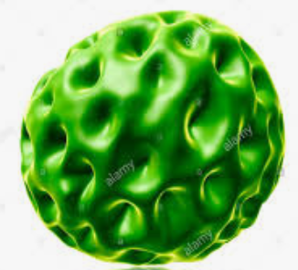
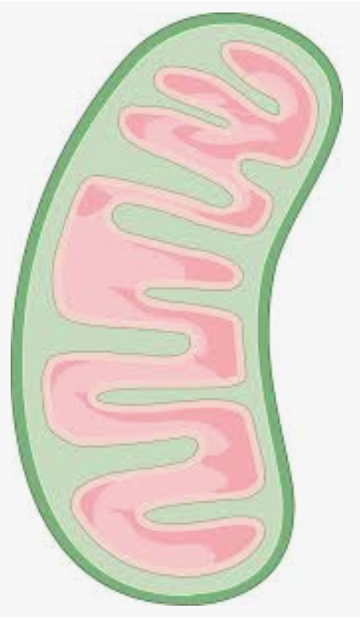
To get more mitochondrias
O2
-
+
OXFOS
Sirtuin diet
Cold exposure Endurance activity

Slide 29
APOE4 = strongest know risc f. of Alzheimer disease
Cells expressing APOE4 variant
3-fold more EB of strain C.pneumonia AR-39 attach than homozygous apoE3
Chlamydophila trachomatis EB no enhancement of attachment apoE4 cells

Slide 30
Thank you for attention
Milliards and awards to who will find a medicament against
C. pneumoniae, which affects cca ⅔ of population and will replace many chronic medications including statins etc.
Longer life to who eat proper plant sources enough now
MUDr. Dana Maňasková

Slide 31
Most important used citations:
Mika A. Brown, Michael G. Potroz, Seoh-Wei Teh, Nam-Joon Cho, Natural Products for the Treatment of Chlamydiaceae Infections, 2016, https://www.ncbi.nlm.nih.gov/pmc/articles/PMC5192522/
Ying Yan, The antichlamydial effects of drugs used in cardiovascular diseases, http://jultika.oulu.fi/files/isbn9789514293153.pdf
Compositions of antichlamydial agents for the diagnosis and management of infection caused by chlamydia, US Patents, číslo: EP0981372 A2, https://encrypted.google.com/patents/EP0981372A2?cl=un
Dautry-Varsat, Ray A. Hawkins, Kathy A. Kelly, Roger G. Rank and Alice, David M. Ojcius, Yolanda Bravo de Alba, Jean M. Kanellopoulos, Internalization of Chlamydia by Dendritic Cells and Stimulation of Chlamydia-Specific T Cells http://www.jimmunol.org/content/160/3/1297 , 1998; 160:1297-1303; J Immuno
Alvesalo J1, Vuorela H, Tammela P, Leinonen M, Saikku P, Vuorela P.; Inhibitory effect of dietary phenolic compounds on Chlamydia pneumoniae in cell cultures; Biochem Pharmacol. 2006 Mar 14;71(6):735-41. Epub 2006 Jan 18; https://www.ncbi.nlm.nih.gov/pubmed/16414027
http://www.academia.edu/3112558/Flavonoid_myricetin_quercetin_kaempferol_luteolin_and_apigenin_content_of_edible_tropical_plants
Further citations and much more info here:
http://medicinman.cz/?p=nemoci-sympt/chlamydie/literatura

