Slide 1
Intestinal permeability
and some antiageing aspects
Dana Maňasková

Slide 2
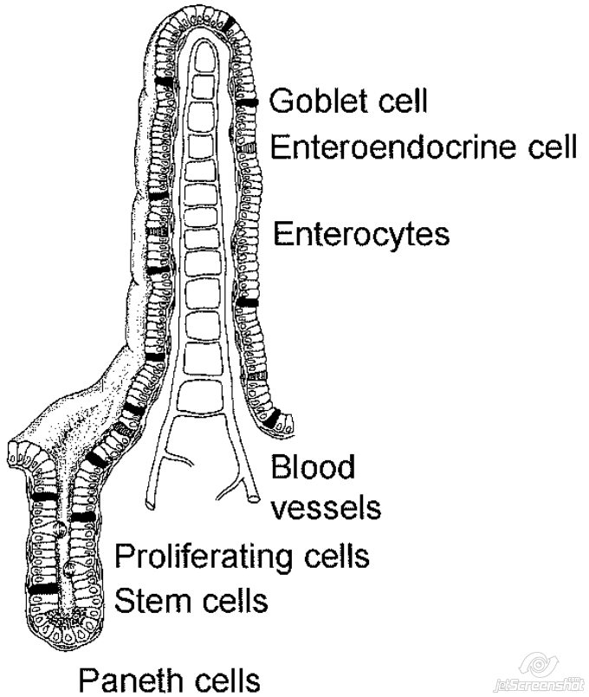
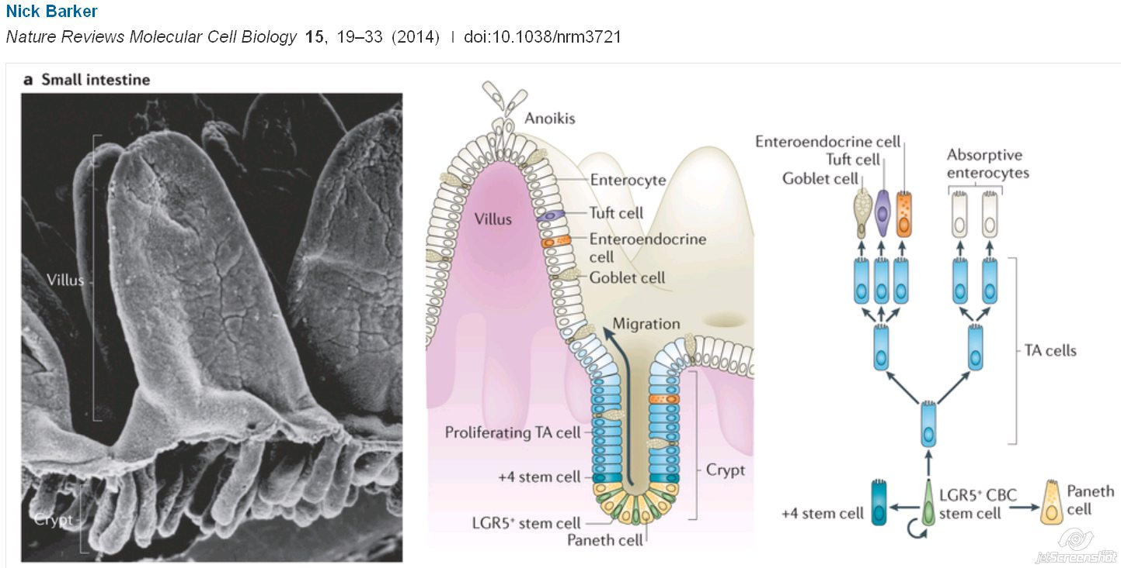
Intestinal barrier - importance
Most extensive and important mucosal surface of body
surface of about 400 m2
Cca 40% of the body’s energy expenditure [10]
Single layer of cells - selective filter and permeability
Immunity cells:
Intraepithelial lymphocytes (GALT)
M-cells
Dendritic cells

Slide 3
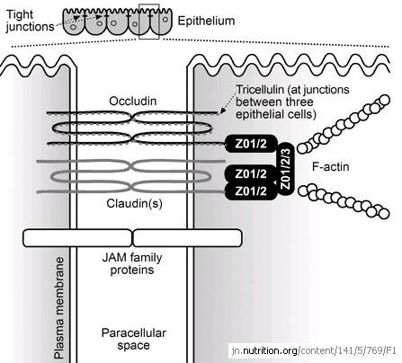
Intestinal barrier consists of:
Vascular endothelium, lamina propria
Secretions - mucus layer: Water layer, mucin - MUC2, epithelial enzymes, ALP
IgA, defensins (Paneth cells), Trefoil factor 3 (Goblet cells)
cytokines, inflammatory mediators
Epithelial cell lining
lipid bilayer membrane
membrane transport systems - Aqueous pores, endocytosis - lipophilic
autophagocytosis, regeneration, cell shedding
Intercellular connections - Paracellular permeability
zonulae occludentes - tight junctions (TJs)
Transmembrane proteins - Fibrils
Occludin, Claudins
Intracellular proteins
Tricelluin, ZO-1, ZO-2, ZO-3, Myosin light chain (MLC)
zonulae adherentes - adherence junctions (Ajs)
Junctional adhesion molec. (JAM) = Coxsackie + adenovirus receptor
maculae adherentes - desmosomes
gap junctions - Cell-cell adhesion and intercellular communication [11]
paracellular pores
Glycocalyx
Intraluminal - fiber, chelatators, bile acids, probiotic bacteria
Peristaltic movements

Slide 4
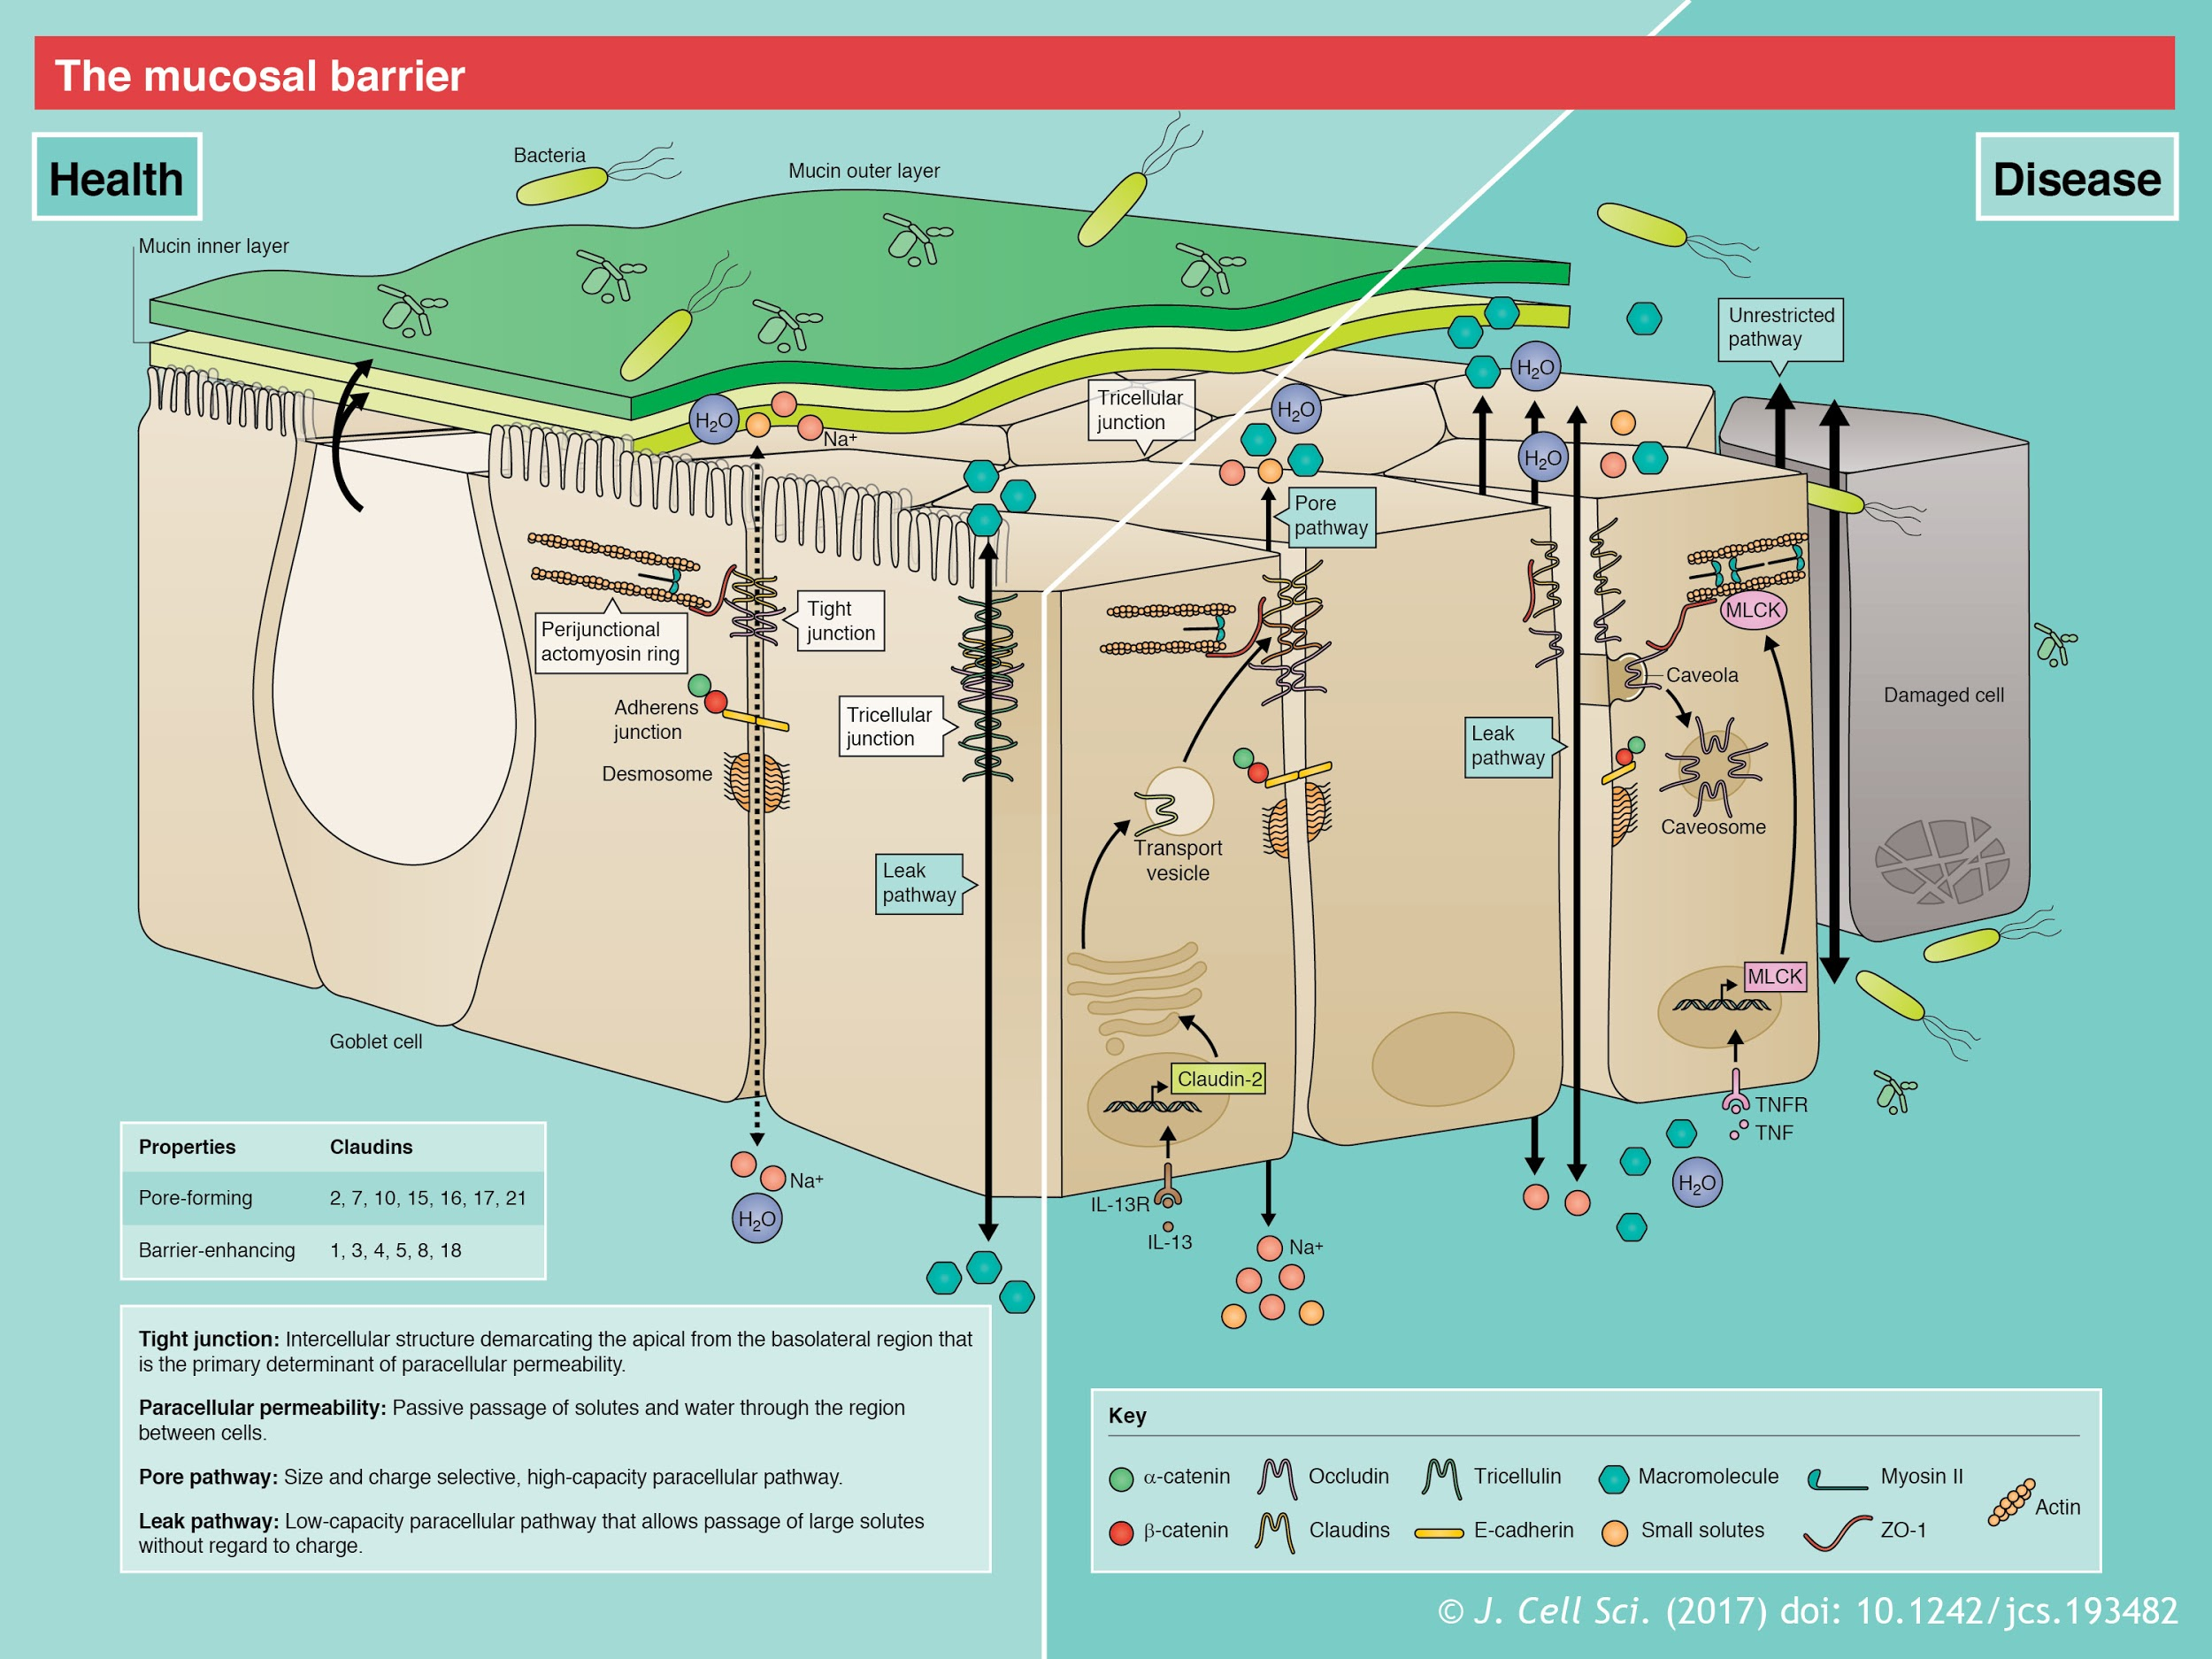

Slide 5
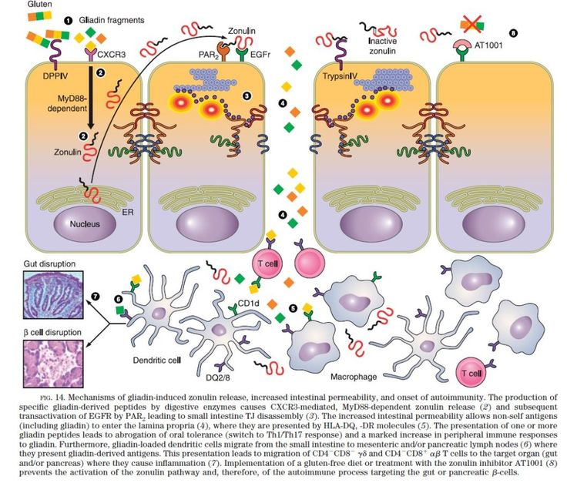
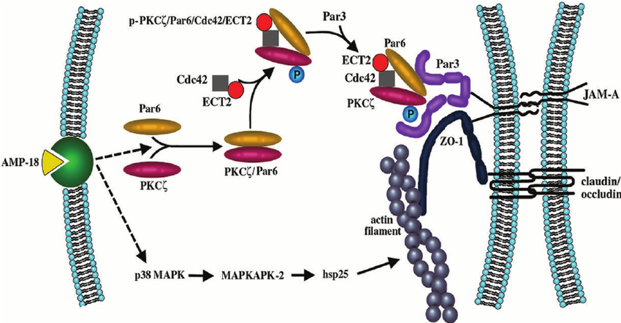

Slide 6
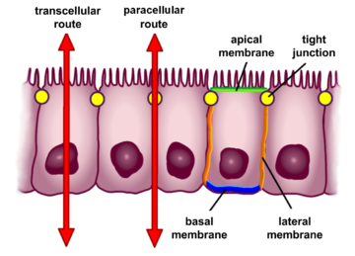
Ways of increased intestinal permeability
Transepithelial permeability
Paracellular permeability
Change or loss of any of the structural proteins
Regulation of the proteins (from DNA to proteinases)
X Tight junctions and other junctional proteins
Pores etc.
Killing epithelial cells
Necrosis / apoptosis triggers
Oxidative stress
Inflammation - infect., autoim, degener.,
Chemical stress (osmotic, reactive molecules etc.)
Microbial action
Food / environmental toxins
Energy supply (blood, oxygen, butyrate, etc.)
Genetic disposition, hormonal regulations,...
Mechanical (x mucous function, muscular, anatomy)
X Regeneration - proliferation
Cytostatics, radiation, different deficiency, toxins
NO SINGLE MOLECULE can consistently reverse intestinal permeability and proof a regress of related diseases in big clinical studies…
Too many different factor combinations in every individual person.

Slide 7
Larazotide acetate - AT-1001 - Zonulin receptor antagonist
Probed in clinical trials, Drug candidate for use in conjunction with a gluten-free diet in celiac disease
To reduce the intestinal permeability caused by gluten and its passage through the epithelium [1]
Does not prevent gluten-induced permeability increases in celiac disease patients [15]
Reduce diabetes and IBD in the non-obese diabetic and IL-10 knockout mouse models [15]
Reduced gluten-induced immune reactivity and symptoms in patients with coeliac disease undergoing gluten challenge and was generally well tolerated; however, no significant difference in LAMA ratios between larazotide acetate and placebo was observed.

Slide 8
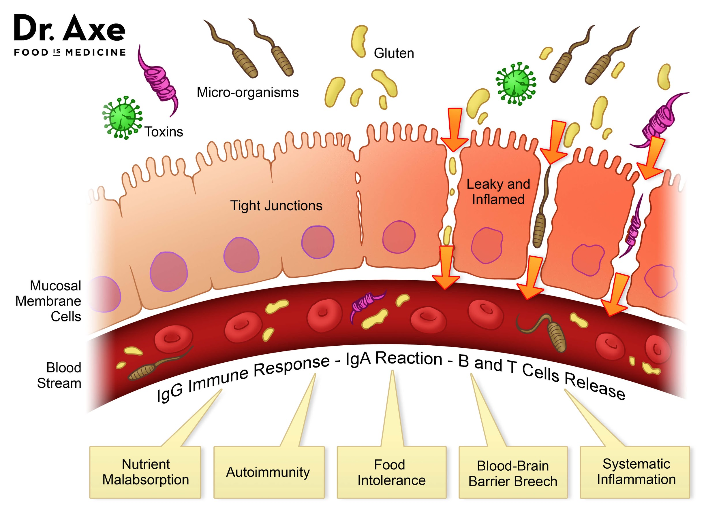

Slide 9
Potential effects of increased intestinal permeability
Increased intestinal permeability
Passage of microbes, microbial products, and foreign antigens into the mucosa
Antigen presented within the gastrointestinal tract - APC
onset of mucosal inflammation [16]
Genetic susceptibility of immune system to:
Misinterpret an environmental antigen - autoimmunity diseases
Immunisation - allergy mosaic, celiac disease
Secretion of inflammatory mediators [1] - progress of degenerative diseases
Inefficiency to kill some sorts of microbes - different IBDs
1st symptoms / progress / recidiv
Chronic weak inflammation
= oxidative stress
= risc factor of quicker degeneration etc...

Slide 11
Associated to increased intestinal permeability
Inflammatory bowel disease
Irritable bowel syndrome - even mild period
Crohn's disease
Celiac disease, Dermatitis herpetif. Duhring (DH)
Ulcerous colitis
NEC
Other diseases
Type 2 diabetes
Schizophrenia
Obesity
Fatty liver - Steatohepatitis [16]
Autism
IgA nephropathy [11]
Primary biliary cirrhosis [12]
Certain types of cancer
Glioma
Chronic fatigue syndrome [14]
Chronic heart failure [14]
Psychological conditions [14]
Autoimmunity
Type 1 diabetes
Rheumatoid arthritis
Juvenile onset arthritis [13, 14]
Psoriatic arthritis
Spondyloarthropathies
Ankylosing spondylitis + Helicobacter p.
increased gastric permeability
Atopy - eczema, Chronic urticaria [10], Asthma
Allergic diseases [1]
Multiple sclerosis [4]
Chronic urticaria
IgA nephropathy [11]
Multiple sclerosis [11]

Slide 12
Differential diagnosis of chronic diarrhoea [3 weeks +] and IBS
Others
Gynecological x, Uremia, Diabetes, Sclerodermia, Hyperthyreosis, Neuropatias, Hypocorticalism, HIV, food allergy, X disacharidasis
Side effects
Antibiotics, Cytostatics, Some antihypertension medic. Inl. diuretics, Antiarhytmics, Antacids with Mg salts, Dihydroxy bile acids, Colchicin, Glycosides
Infections
Giardia lamblia
Entamoeba histolytica
Clostridium difficile
Campylobacter
Yersinia
Inflammations
M. Crohn, Celiac sprue, UC, Proctocolitis, Collagenous colitis, M. Whipple, Divertikulitis, Lymphocytary colitis
Cancers
Vipoma, Carcinoid, Lymphoma Zollinger-Ehlers syndrome, Colorectal carcinoma, Amyloidosis
Hepatobiliary case
X pancreas
Behaviour
Sorbitol, Xylitol, ...-ol
Fructose
Alkohol
Coffee
Intoxications
Gluten
Fibre
Insolation syndrome
Neurological ???
Enteropathy, Neurodigestive astenia, Irritable anus, Incontinentia
Psychiatric
Carcinophobia, Hypochondria, delusions, phobia, obsession, Mental anorexia or bulimia, Psychical stress [angry, nervous]
Post OP
Vagotomy, gastrectomy, pancreatic resection, cholecystectomy, short bowel sy., end loop sy.

Slide 13
Meteorism, tenderness/pain, diarrhoea - “GIT irritation” - “IBS with diarrhoea predominance”
What can gastroenterlogist do for You?
What do You do for Your intestinal mucosa to get healed ?
Exclude tumor/cancer, Crohn disease, ulcerous colitis and other inflammations
Exclude celiac disease, lactose intolerance +-
Do colonoscopy and biopsy and find nothing conclusive
Send You to allergologist - tests on food allergies - no extra change after food elimination
And prescribes a symptomatic teraphy - resume of czech guidelines and study material for doctors:
Antigasses: Espumisan (simeticon) [26], oligosacharide low diet (in better case)
Antispasmolytics musculotropic: otiloniumbromid, mebeverin hydrochlorid, trimebutine hydrogen-maleát, alverin, drotaverine, papaverin, pitofenon, pinaverin, propiverin [26][27]
Antidiarrhoics: dinfenyloxylate, loperamide (Imodium), calcium carbonicum precipitatum, magnesium-aluminium silicate (Smecta) [26]
Antidepressants: paroxetine (SE: fracture risk), sulpirid (SE: glactorrhoea), amitriptyline (anticholinergic) [26][27]
Anxiolitics: oxazepam, alprazolane [26]
5HT receptor antagonist: cilasetrone, alosetrone (SE: ischemic colitis, refracter obstipation) [26]
Chelatation: cholestyramine in case of cholecystectomy [26]
And the patient´s problem ? Becomes a chronic one !!!

Slide 14
What can we do for our intestinal mucosa to get healed ?
If no one single commercial molecule has proven effect big enough?
Because of too many unknown factors?
Try to influence as many possible causal factors as possible in the same time:
Eliminate food and pills (if possible) that are known to X GIT mucosa and healing
Prefer food with healing effects (antioxidants, anti-inflammatory diet, antiallergic,...)
Suppress possibly pathogenic bacteria
Support friendly bacteria
Specific nutrients / stimulants for mucosal epithelia and GIT barrier regeneration
Mucosal immunity, IgA secretion, mucous production, edema reduction etc.
Good blood supply of GIT
Psychical stress reduction
Good sleep
And this is a short summary
of what my presentation will be about today
AND DO IT LONG ENOUGH

Slide 15
Some of the IP causing agents
Health condition:
All GIT sorts of inflammation
Inflammations and autoimmunity with elevated: IFN gamma, IL-2, IL-13, TNF alpha, CRP, IL-6 …
including obesity with its low intensity inflammation !!!
Undernourishment, Prematurity, different vitamin, minerals and nutrients deficits
deficit of ferrum (by deficit of vitamin C), zinc, folate, B12, other Bs, proteins, phospholipids, antioxidants...
Enzyme deficiency, bile deficiency, IgA deficiency
Ischemia of the GIT, hypoxia, mucus secretion defic., x motility or anatomy of GIT
Psychological stress itself
= ALMOST EVERY HEALTH CONDITION CAN BE ASSOCIATED WITH IP !!!

Slide 16
Some of the IP causing agents
Therapeutics:
Hydrogen peroxide, radiotherapy, chemotherapy, imunosupressants, methotrexate, Tacrolimus, Chitosan [(poly-D-glucosamine) a food additive], NSAIDs, proton pump blockers, corticoids,...
X ACEIs or ARBs resulted in reduction in colitis severity
= Disturbing mucoso-immuno-microbial balance or not ?
Microbial:
Intestine bacterial overgrowth
Protracted infections:
Enteroinvasive E. coli (EIEC) strains, E. coli endotoxin, Campylobacters, Helicobacters, Yersinias,...
Opportunistically invasive commensal bacteria:
Salmonella enterica Serovar Typhimurium (Salmonella typhimurium)
Enterococcus faecalis, Candidae etc…
Individual faecal PCR analysis test in the future??

Slide 17
Food to avoid:
Gliadin - gluten [ wheat, barley, rye ]
activates zonulin signaling (release)
irrespective of the genetic expression of autoimmunity
Increased IP to macromolecules - even in healthy people !!!
Inhibits cell growth, Induces apoptosis, alters redox equilibrium
Cow’s milk intolerance and other food allergies and allergens
Alcohol and acetaldehydes
helps resorption of different molecules
Solanaceae spices - pepper , paprika, tomatoe [tomatin], potatoe [solanine]
Lectines, saponines
sprouting and fermenting reduces phytates and lectins
GMO and hybridized foods - highest in lectins - modified to fight off bugs [20]
Emulsifiers
destabilization of tight junctions, industrial food processing

Slide 18
Food to avoid:
Surfactants - Decrease the hydrophobicity of the mucus layer
Sucrose monoester fatty acid - Food-grade surfactant
increase in the permeability of the egg white allergen ovomucoid
permitted in infant milk formulae i high amounts
Glucose - paracellular water flow and increased paracellular permeability
solvent drag
MUFA, PUFA, Organic solvents
Salt - Paracellular Na+ flow associated nutrient transport
Sulfur-containing amino acids - cystein cystin - PLUS AND MINUS
= many other things like environmental and chemical contaminations of food
just had no more time for longer internet search
=Normal is to prefer basic “clean food”

Slide 19
AGEs: Advanced Glycation End Products
Browning products (glycotoxins) due to the Maillard reaction [10]
Reducing sugars spontaneously react with:
aminopeptides
Lipids
nucleic acids [10]
By diffusion 10–30% in the circulation
correlation with inflammatory markers in healthy: TNFα, IL -6, CRP [26]
Eliminated by:
hepatic sinusoidal Kupffer and endothelial cells [10]
urinary excretion of AGEs [10]
intracellular degradation:
glutathione-dependent glyoxalase system (glyoxalase (Glo) I and II) [26]
fructosamine kinases - break Amadori products [26]

Slide 20
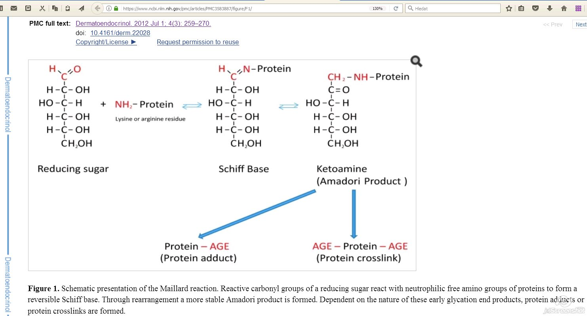
Oxygen,ROS and redox active transition metals accelerate AGE formation
Further oxidation, dehydration, polymerisation and oxidative breakdown reactions = numerous other AGEs:
HbA1c, fructosamine,...
Carboxymethyllysine (CML)
Pentosidine
Pyrraline
Methyl-glyoxal (MG)
Glyoxal
3-deoxyglucosome
Glucosepane
Fructose-lysine
High content in collagen
Irreversible reaction

Slide 21
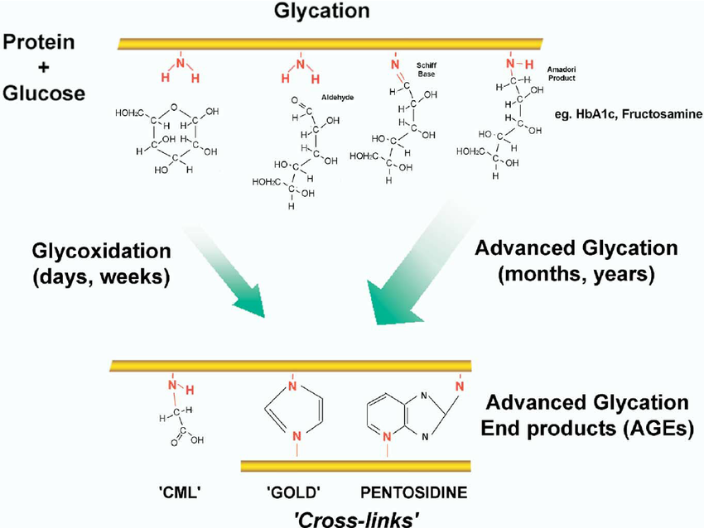

Slide 22
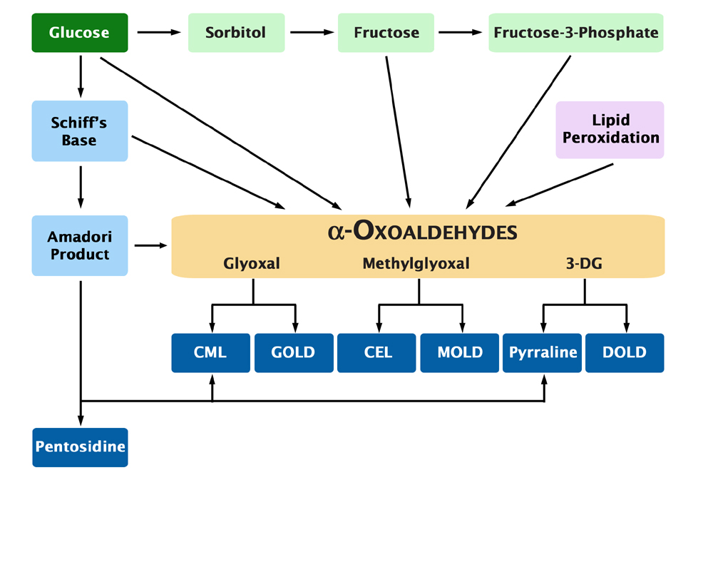

Slide 23
AGEs
Dietary AGEs add to those synthesized endogenously (high glycaemia) [10] (esp. In x kidney function)
binding with cell surface receptors [26]
cross-linking with body proteins - altering their structure and function [25]
smoking, sun irradiation, genetics (removal rate) also influence the rate of AGE formation [26]
UV irradiation stimulates glycation of elastin in the presence of sugars [26]
diabetes, adipocyte x, insulin resistance [25], skin aging, atherosclerosis, kidney x [25]
promotes DNA fragmentation and apoptosis in the liver [10]
modify the gut microbiota [10]
RAGE-induced activation of NFκB - and RAGE synt. - vicious cycle of proinflammatory signals
directly induce oxidative stress by activating NOX
decreasing activity of superoxide dismutase (SOD), catalase and other pathways
reducing cellular antioxidant defenses, like GSH and ascorbic acid
reduction of GSH leads further to decreased activity of Glo I against methylglyoxal [26]

Slide 24
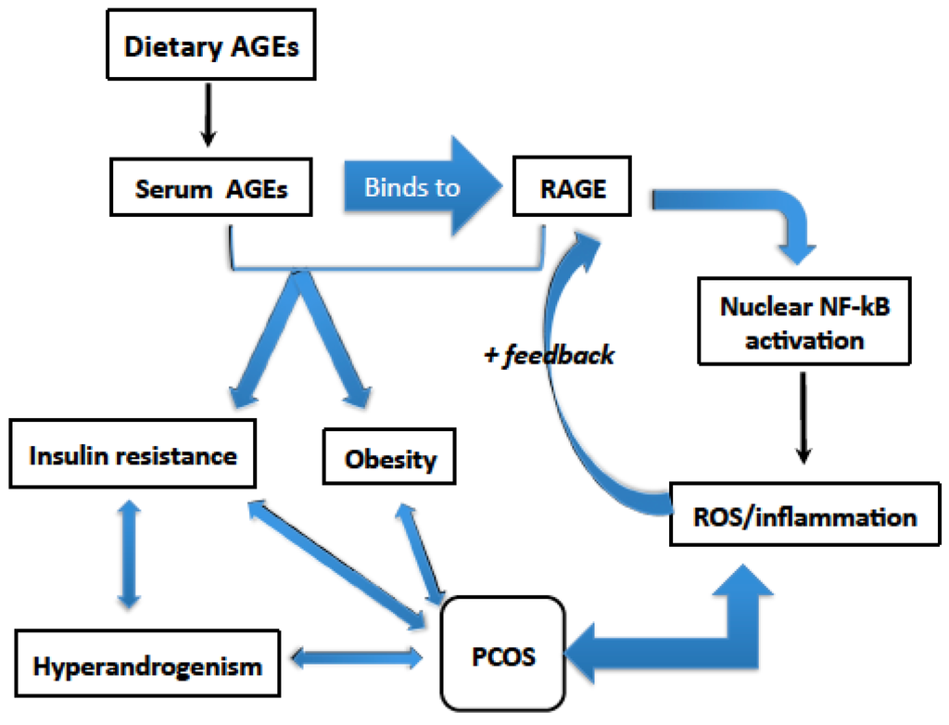

Slide 25
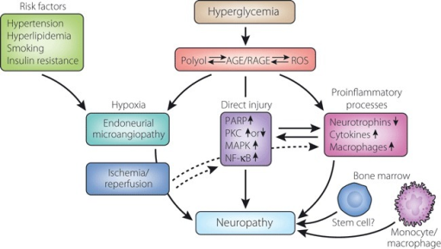

Slide 26
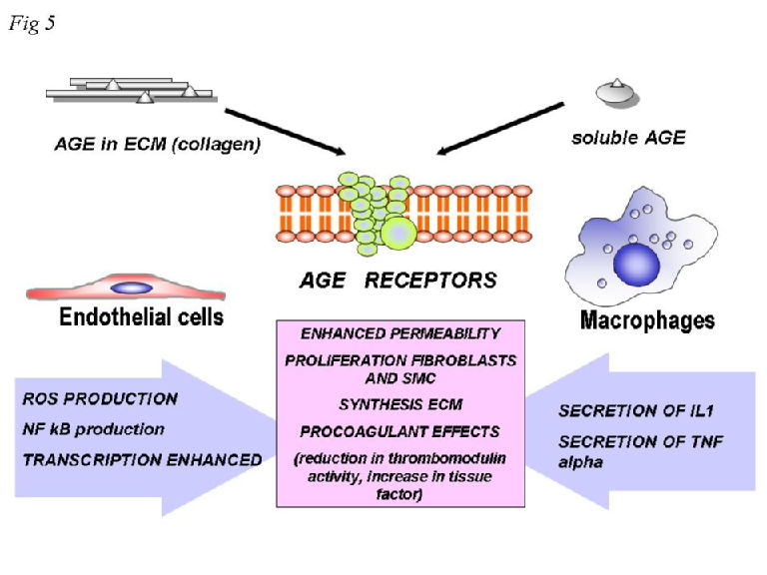

Slide 27
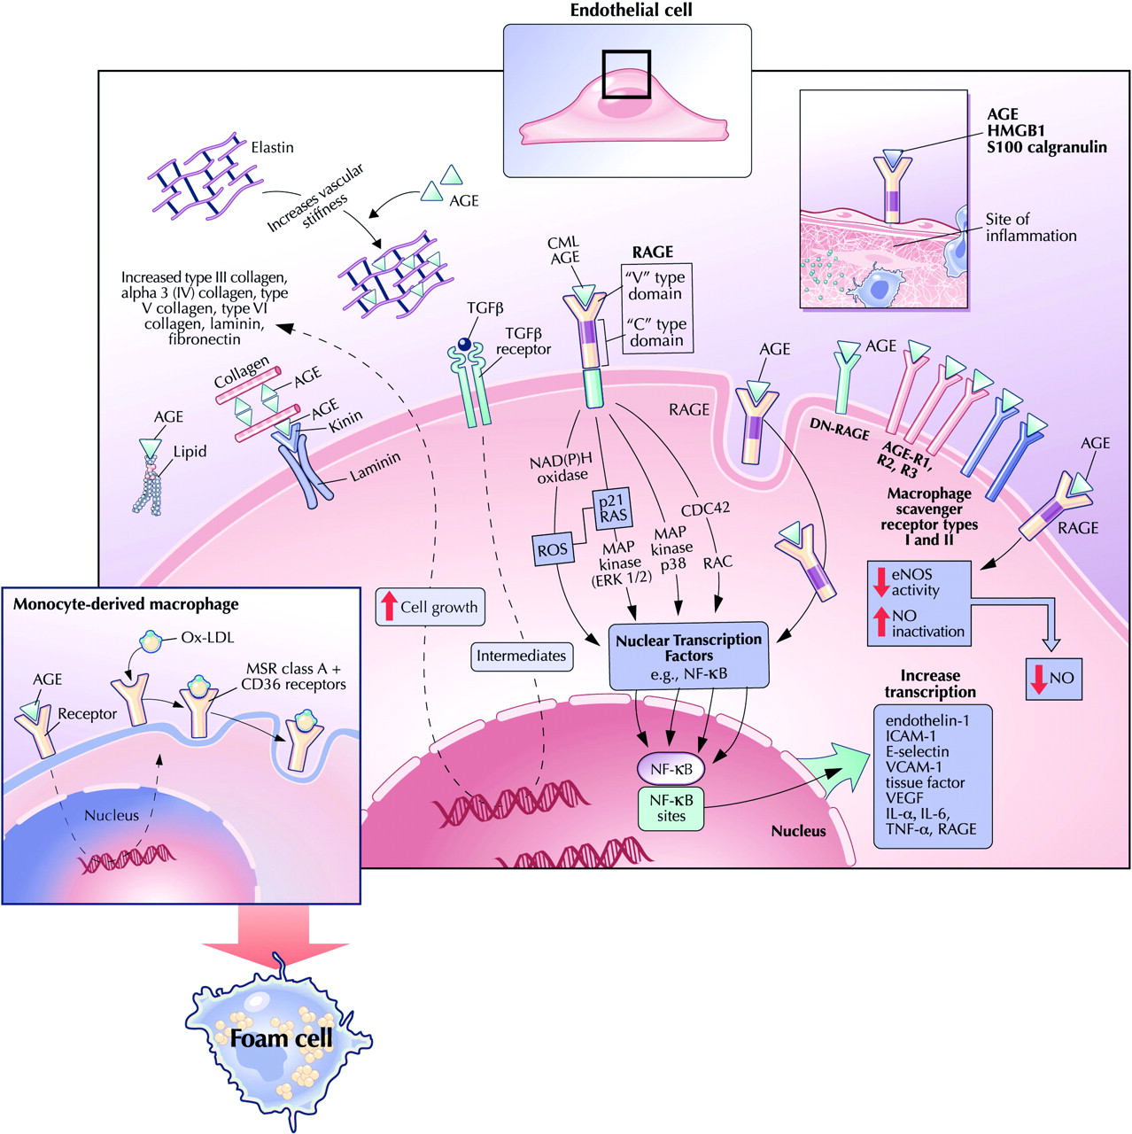

Slide 28
Very high temperatures during food processing
Denature proteins that have lower glycation capacity [10]
Protein digestibility - lower if the diet is rich in browning products [10]
Recognition of epitopes by IgE is diminished [10]
Glycation of food allergens increases T-cell immunogenicity of food allergens [10]
In 30% of humans IgE against processed food higher than raw food antigens [10]
Dry heat - new dAGE formation by >10- to 100-fold above the uncooked across all foods [25]
Broiling (225°C) and deep-frying (180°C), oven-frying (230°C) - more AGEs than roasting [10]
crackers, chips, and cookies - addition of ingredients: butter, oil, cheese, eggs, and nuts before dry-heat processing substantially accelerate dAGE generation
far below those present in meats, but also health hazard
Roasting (177°C) increases allergenicity of peanuts, soya beans [10]
Microwaving - did not raise dAGE as other dry heat cooking methods (6 min less)
Poached or steamed chicken = less than 1/4 the dAGEs of roasted or broiled chicken [25]
Boiling (100°C) least amount of glycated compounds [10]

Slide 29
Safest cooking method
Boiling (moist heat)
shorter times
lower temperatures [10]
Low or acidic pH
arrests AGE development: lemon juice, vinegar marinades [25]
Type of oil:
scrambled eggs + cooking spray, margarine, or oil
~50% to 75% less dAGEs than butter
Antioxidants and vitamins
may diminish new AGE formation [25]
Materials used
contact with metals may stimulate AGEs formation

Slide 30
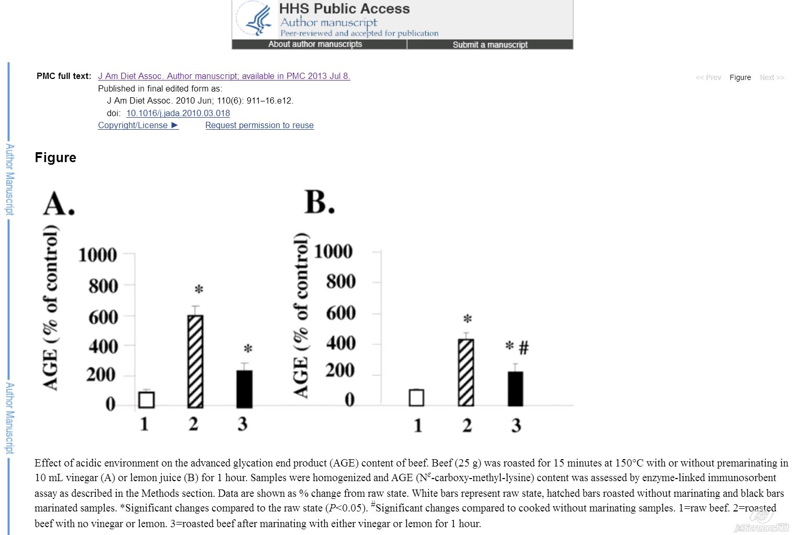
Acidic marinade will help collagens to absorb water and be cleaved… and meat is not hard.

Slide 31
AGEs contents in food https://www.ncbi.nlm.nih.gov/pmc/articles/PMC3704564/table/T1/
Animal-derived fat meals
more AGEs than low fat meat and carbohydrate-rich meals [vegetable etc]. [10]
= not only reducing sugars, but fats are also reactive
= deadly combination in animals
Intracellular:
highly reactive amino-lipids
reducing sugars (fructose, glucose-6-phosphate, glucose, … )
= why butter [from milk full of lactose] can be a bigger problem than oils
Butter, whipped 26,480 [kU/100g],
Margarine, tub 17,520 [kU/100g],
Oil, olive 11,900 [kU/100g],
Oil, sesame (Asian Gourmet) 21,680 [kU/100g]
High in dAGEs when cooked under dry heat
= pro-oxidation conditions

Slide 32
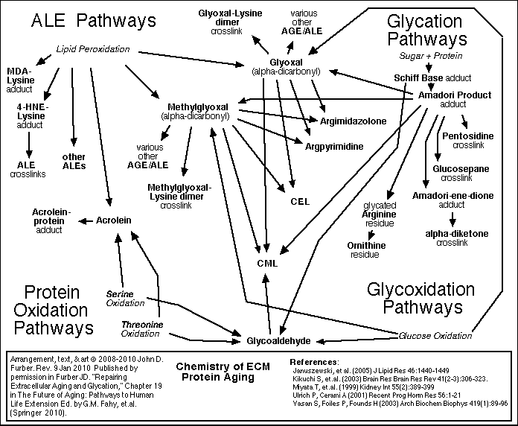

Slide 33
AGEs contents in food https://www.ncbi.nlm.nih.gov/pmc/articles/PMC3704564/table/T1/
Fat + sugar rich meats + dry heat
Pork Bacon, fried 5 min no added oil 91,577 [kU/100g],
Pork Bacon, microwaved, 2 slices, 3 min 9,023 [kU/100g],
Chicken, skin, back or thigh, roasted, 18,520 [kU/100g],
Beef, steak, pan fried w/olive oil 10,058 [kU/100g]
Higher-fat and aged cheeses = higher AGEs than low fat, fresh
full-fat American, Parmesan grated (Kraft) 16,900 [kU/100g] = high AGEs content
Cream cheese, Philadelphia soft, (Kraft, Northfield, IL) 10,883 [kU/100g]
low-fat cheeses: cottage cheese 1,453 [kU/100g]
reduced-fat mozzarella 1,677 [kU/100g],
2% milk cheddar 2,457 [kU/100g],

Slide 34
Cheeses even uncooked can contain large amounts of dAGEs
pasteurization temperatures and times
long times at ambient room temperatures - aging processes
Casein AGEs
form a complex with serum albumin
RAGE is stimulated - induces inflammation - also in intestinal epithelia
Another high fat food with potentially high AGEs
mayonnaise, nuts - esp. roasted
Roasted beverages - brown by caramellisation- oxidation products
Coffee, heating plate >1 h 13.60 [kU/100g],
Coffee, with sugar 7.60 [kU/100g]

Slide 35
AEGs content in food
Polysaccharides (vegetables)
mostly consist of non-reducing sugars
less likely to give rise to AGEs
Grains, legumes, breads, vegetables,
Fruits and milk were among the lowest items in dAGE
unless prepared with added fats or heated !!!
Milk products with a high moisture index (yoghurt, pudding, ice cream)
relatively low in AGEs if not from milk powder
Fructose - strong glycating sugar (more than glucose) - beverages and corn syrup [10]
Rats fed a high-fructose diet = AGE pentosidine accumulates in the aorta and skin [10]
Glycation and oxidative stress occurred preferentially in fructose-fed animals [10]
The HIGHEST values of AGEs?
Fast food: fats, sugars and frying and oils overfrying...
reheated smoked meats incl. bacon and fatty cheeses
even white flour reheated
Added sugars in cereals, meats, soups etc. before heating a food !!!

Slide 36
Inhibition of AGEs accumulation
Pyridoxamine
traps reactive carbonyl intermediates, scavenges ROS
inhibits post-Amadori stages of AGEs formation
promising in a phase II clinical trial against DM nephropathy [26]
Ascorbic acid, α-tocopherol, niacinamide, pyridoxal, sodium selenite, selenium yeast, trolox, rivoflavin, zinc and manganese
shown to inhibit glycation of albumin in vitro
Vitamin C supplementation
significantly decreased serum protein glycation
Alpha-lipoic acid
reverse tail tendon collagen glycation in fructose-fed rats
ability to recycle ascorbic acid, α-tocopherol and GSH
N-acetylcystein with taurine and oxerutin
inhibit skin collagen glycation in mice
Epigallocatechin-3-gallate
antagonizing AGE-induced proinflammatory changes in the body
Many spices and herbs inhibit glycation of albumin in vitro
ginger, cinnamon, cloves, marjoram, rosemary, green tea and tarragon
protective effects correlated with phenolic content
Naturally occurring flavonoids: luteolin, quercetin and rutin, blueberry extract
can inhibit various stages of AGE formation [26]
Metformin - inhibitory action on AGE formation (from Galega officinalis)

Slide 37
Inhibition of AGEs accumulation
Autophagocytosis
cytoplasmic materials degraded in lysosomes
maintain cellular homeostasis during cellular starvation by recycling damaged organelles and proteins
part of malignant transformation of cancer cells into stem-like cells that are enormously resistant and vital
induced by caloric restriction
“Skin collagen glycation and glycoxidation inversely correlated with lifespan whereas caloric restriction led to decreased accumulation of AGEs and increased lifespan.” [26]
Metabolic adaptation and less energy burning and less need to eat as a problem ?
Intermittent fasting diet (2 times a day) as an extra 5th phasis extension of metabolic balance for extra well adapted clients who want to do even deeper change and live even longer :-)))
Is there a way back to a common food without refeeding reaction - jojo effect?
To stop suddenly might be really big problem.

Slide 38
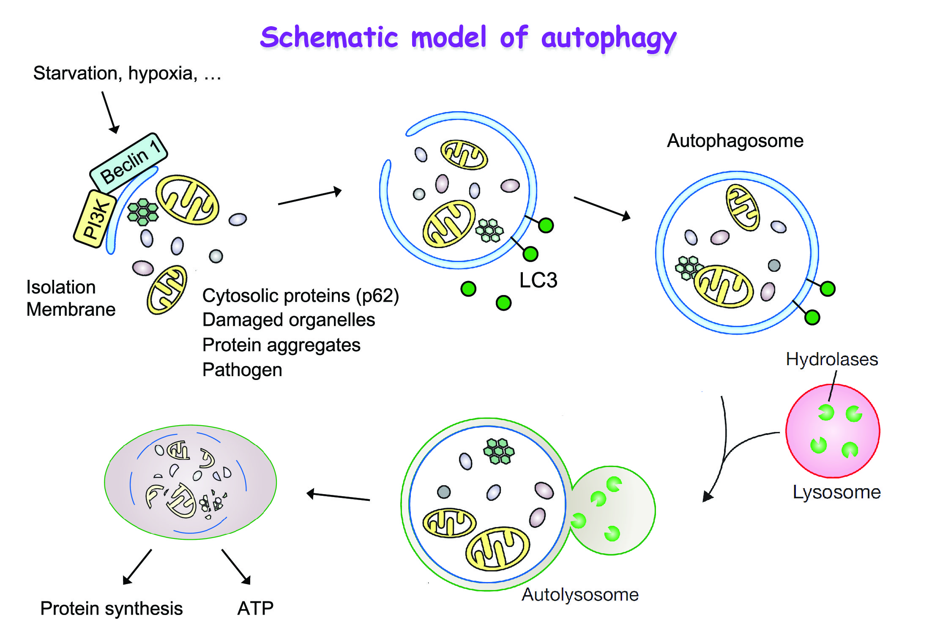

Slide 39
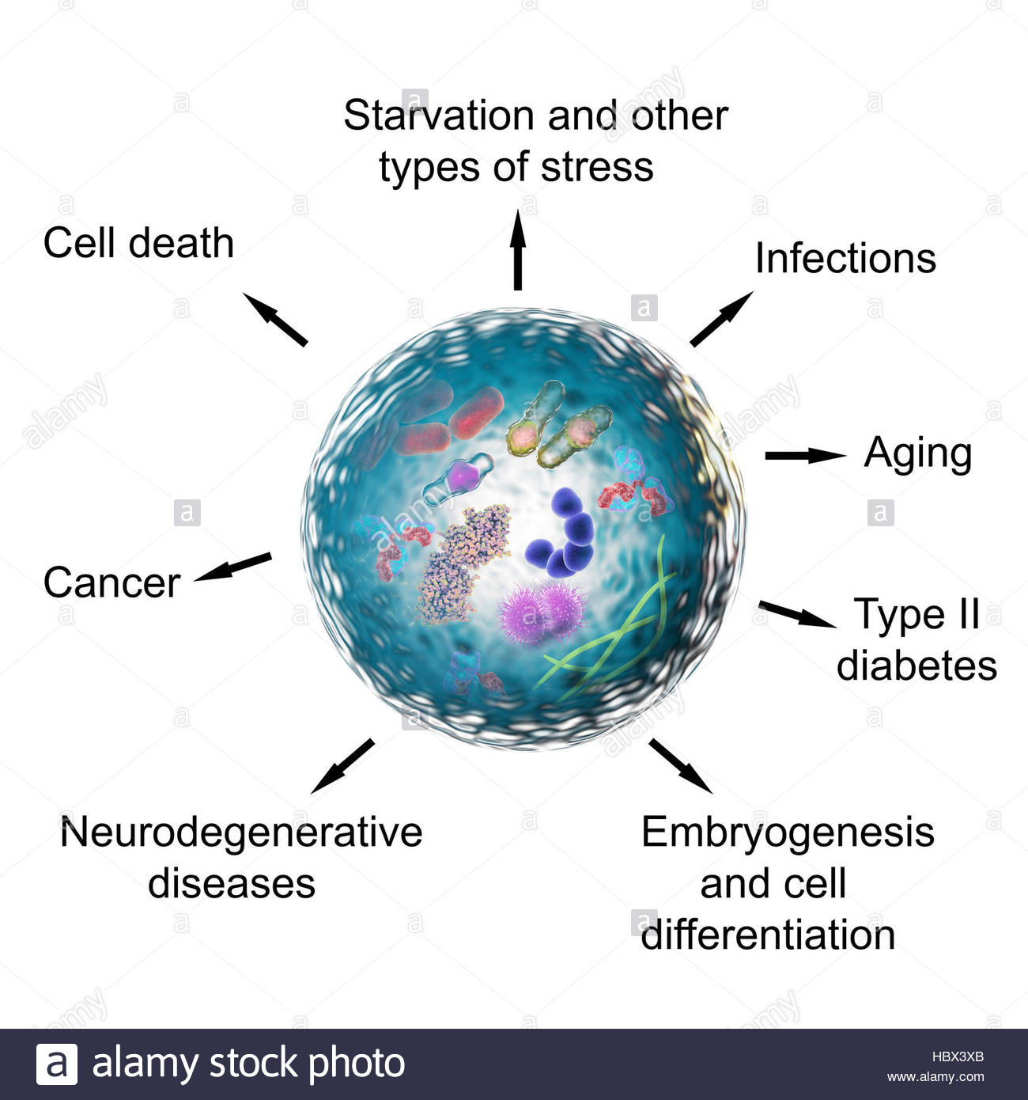

Slide 40
Summary: What to avoid to reduce IP
Minimize AEGs (restrict fried fats and added sugars in any food)
No gliadine (gluten)
Ex allergens - esp. primary ones - cow milk ev. other known ones
Avoid lectines and saponines, solanaceae family (potaoes, lilac, tomatoes, curbis, peppers, chilli, etc.)
Minimize concentrated / quick sugars and salt
Alcohol
Foods rich in omega6, arachidonic acid, animal fats
No food with emulgators, other unnecessary food chemical additives
Mycotoxines, NSAIDs,...
Stress
If pain and bloating - no sugars

Slide 41
Some of the IP reducing agents
Microbionta
Salmonella enterica Typhimurium - Secreted AvrA
Bifidobacterium strains
Lactobacillus strains
Butyrate-producing bacteria - Efficacy in experimental models [16]
Supplementation with butyrate-producing species or probiotics
Faecalibacterium prausnitzii - UC patients have reduced [16]
Butyrate - by intestinal microbial fermentation of dietary fibres [16]
E source for intestinal epithelial cells [14]
Maintain barrier function of the colonic mucosa [14] - facilitating TJ assembly [11]
Stimulates mucus production and expression of TJs in vitro
Deficiency in faecal concentrations - Indirect indicator of altered barrier function [16]
Topical butyrate proved efficacy in refractory distal UC [16]
Inhibit inflammation and reduce oxidative stress [14]

Slide 43
Soluble fiber promotes growth of beneficial Bifidobacteria
Primary source of intestinal short-chain fatty acids incl. butyric acid [14]
Flaxseed fiber - 1-5g/d [14] - Help maintain normal barrier function in the distal colon
Psyllium seed Husk - 1-5g/d [14]
After 3 months of treatment, patients in the psyllium group
Significant reduction in symptom severity in IBD
Clinical trial, combined treatment with psyllium and probiotic Bifidobacteria and Lactobacilli
Significantly improve symptoms of diarrhea and abdominal pain in patients with Crohn’s disease [14]
Prebiotics
Reduced gut permeability in atopic dermatitis [10]

Slide 44
E. coli Nissle 1917 - Mutaflor® (Ardeypharm GmbH, Herdecke, Germany and EcN, Cadigroup, In Italy)
Nonpathogenic Gram-negative strain EcN 1917 (O6:K5:H1)
Prof. Alfred Nissle, [Ge], 1917 - from 1 healthy soldier’s stool in WWI in Balkan endemy of Shigella diarrhoea [18]
Used in many GIT disorders:
Diarrhea, Uncomplicated diverticular disease, UC
The only probiotic in ECCO guidelines as alternative to mesalazine to keep remission in UC patients [18]
Found to reduce increased intestinal permeability [1] [16],
Leaky gut was also improved [10]
Increased expression of ZO-2 and 1 protein [11]
Lack of defined virulence factors: Alpha-hemolysin, P-fimbrial adhesins, etc. [18]

Slide 45
Expression of fitness factors:
Microcins
Different iron uptake systems: Enterobactin, Yersiniabactin, Aerobactin, Salmochelin,
Ferric dicitrate transport system, Chu heme transport locus [18]
Support its survival and efficacious colonization of the human gut
Adhesins, Proteases
Contribute to the probiotic character of EcN 1917 [18]
Colonizes the intestine within few days
Remains as colonic flora for months after administration [18]
Does not produce known toxins
Intestinal anti-inflammatory effect - also systemic effects [18]

Slide 46
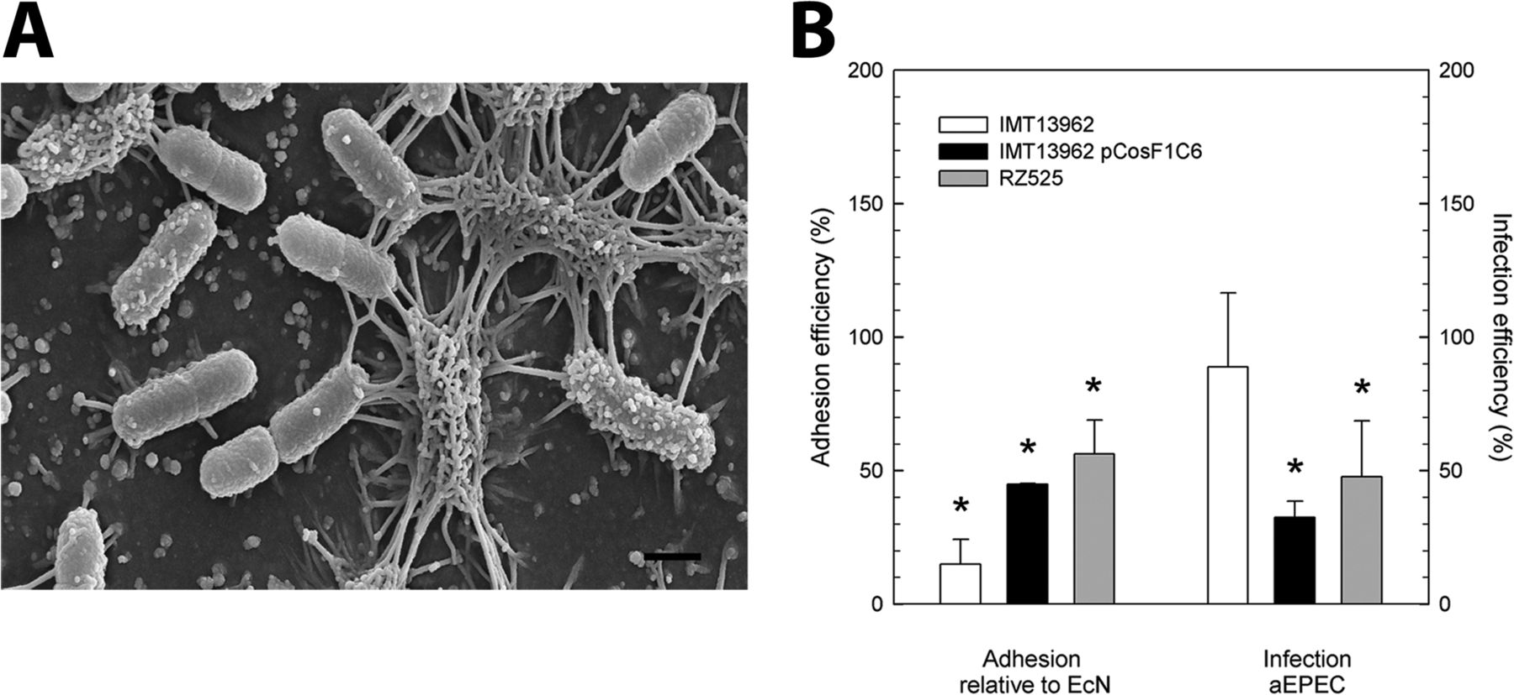

Slide 47
Direct antimicrobial effects of E. coli Niessle - INHIBITS:
EHEC (E. coli EDL933) colonization in animal models
Synthesis of Shiga -Toxins in co-cultivation experiment with STEC (Shiga-Toxin producing E. coli)
Expresses F1C Fimbria - important in the formation of biofilm, adherence to epithelial cells and persistence [18]
Flagellum - efficiently compete with pathogens for binding sites on host tissue [18]
Directly stimulates defensin production by intestinal epithelial cells
Human beta-defensin - Inhibits adhesion and invasion of pathogenic adherent invasive E. coli
Key role as trigger in immune response in IBD patients [18]
Strengthens tight junctions of intestinal epithelial cells
Up-regulating the expression of the mRNA for the zonula occludens proteins ZO-1 and ZO-2
Effect on the repair of the “leaky gut” [18]

Slide 48
Decreasing in pro-inflammatory cytokines
IL-2, TNF-alpha, IFN-gamma
Increasing anti-inflammatory cytokines by peripheral blood mononuclear cells Decrease intestinal inflammation
Doesn’t affect activated tissue-bound T cells
Specific LPS - Immunogenicity, without major immunotoxic properties at doses suggested [18]
Microcins
Enable Escherichia coli Nissle 1917 (EcN) to limit the expansion of:
Competing Enterobacteriaceae (including pathogens and pathobionts) during intestinal inflammation
Commensal E. coli
Adherent-invasive E. coli
Related pathogen Salmonella enterica [19]
Cross outer and inner membranes of Gram-negative bacteria and supress transkription etc.

Slide 49
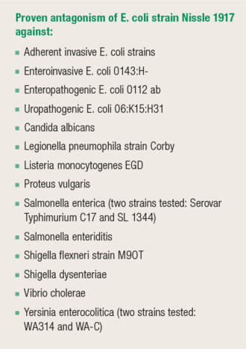
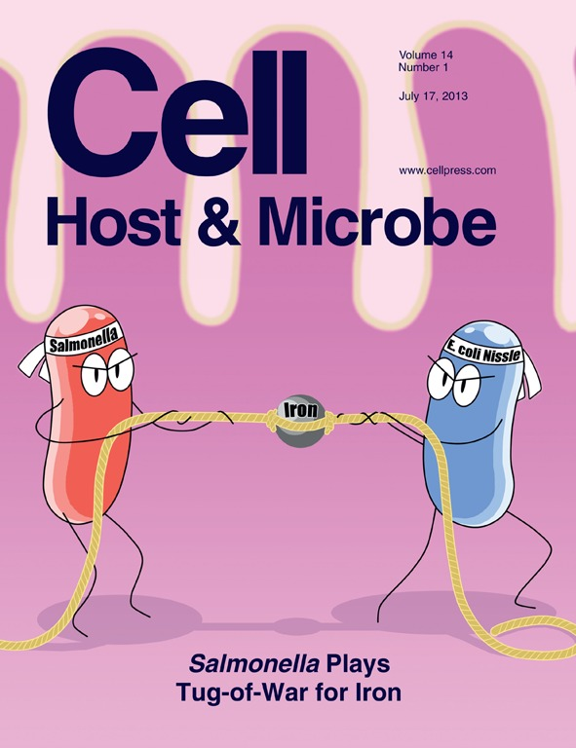

Slide 50
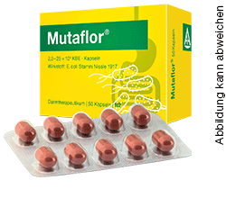

Slide 51
Food to prefer:
Antioxidants !!!
Folic acid - epithelial proliferation:
AMK: glutamine, arginine, tryptophan, citrulline [16]
Beta - Lactoglobulin (from skim milk)
Casein peptide Asn-Pro-Trp-Asp-Gln
Autophagy - involved in the regulation of TJs by degradation of a pore-forming claudin [16]
Black tea (Camellia sinensis) - Epigallocatechin gallate
Curcumin (turmeric) - Efficacious in experimental colitis
Eff. in colonic inflammation in multidrug-resistant mice with IBD
Should be used at moderate doses - At high doses it can enhance oxidative stress
Grape seed proanthocyanidines (GSPs) - proanthocyanidins
Jogurt and Kefir

Slide 52
Folic acid - crucial for reducing homocystein levels
Methylation Nutrients (Vitamins B6, B9, B12, and biotin) - perhaps the most critical to keep the body producing glutathione - esp. Folate Foods:
Garbanzo beans (chickpeas)
Liver
Pinto beans
Lentils
Spinach
Asparagus
Avocado
Beets
Black eyed peas
Broccoli
Navy Beans
Kidney Beans
Lima Beans
Collard Greens
Turnip Greens
Mustard Greens
Romaine Lettuce
Papaya
Oranges
Grapefruit
Strawberries
Raspberries
Lentils
Pinto Beans
Garbanzo Beans
Black Beans
Okra
Brussels Sprout
Cauliflower
Dark Leafy Greens
Citrus
Being destroyed by cooking !

Slide 53
Food to prefer:
Fibers - flax seed, psyllium, Fiber from brassica, …
Fatty acids: Propionate, Acetate, Butyrate
Extra virgin olive oil
PUFA: Conjugated linoleic a. (CLA), Gamma-linolenic a. (GLA) - 200–400 mg, Docosahexaenoic acid (DHA), Eicosapentaenoic acid (EPA) [14],
In membrane phospholipids fraction of human mucosal epithelial cells
reduce mucosal permeability caused by inflammatory cytokines [14]
Soy milk fermented - by L. plantarum, Lactobacillus fermentum, and L. rhamnosus
Bromelain - Pineapple [20] - Anti-inflammatory effect via proteolytic activity
reduce CD4+ T-cell infiltrations
improvement of clinical and histologic severity of colonic inflammation
Germinated barley foodstuff - Dietary fiber and glutamine-rich protein
function as a probiotic [20] effect. In UC
Wheat grass (Triticum aestivum)

Slide 54
N-acetyl-D-glucosamine (NAG) - 375–750 mg [14]
In large concentrations in: Intestinal mucus, secretory IgA and Other Igs
Blocks the adherence of Candida albicans to the GIT mucosa
Stimulates the growth of beneficial Bifidobacteria in vitro
Is deficient in the mucin of IBD patients
X in the biosynthesis [ N-acetylation of glucosamine-6-phosphate to form NAG, etc.]
Absorbed from the gut lumen
Directly incorporated into glycosaminoglycans and glycoproteins of GIT mucosa [14]
Children with severe UC and Crohn’s disease unresponsive to conventional treatment
NAG p.o. or rectally, 3–6 g daily
8 of 12 children had clear improvement [14]
Symptomatic Crohn’s stricture
4 out of 7 - endoscopic and X-ray improvement and avoid surgery over follow-up of 2.5 years [14]

Slide 55
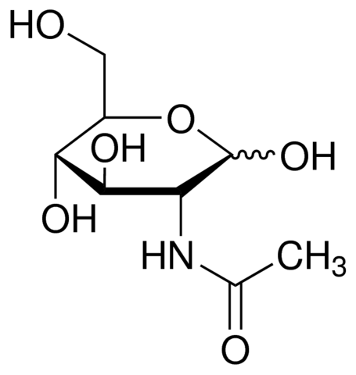
What is N-acetyl-D-glucosamine (NAG) ?
amide between glucosamine and acetic acid naturally:
part of a biopolymer of bacterial cell wall,
monomeric unit of the polymer chitin
isolated from crab and shrimp shells, squid endoskeletons
major component of the cell walls of most fungi
polymerized with glucuronic acid forms hyaluronan, keratan sulfate
in cartilage, cornea, in skin, blood vessel, bone tissue, mucosa
linked to serine or threonine residues - O-GlcNAc proteins and others
ubiquitous post-translational protein modification
O-GlcNAc levels of soluble tau protein in brains with AD are markedly lower than in healthy brain
inhibitor of elastase release from human polymorphonuclear leukocytes
oral polymeric N-acetyl-D-glucosamine
useful in treating patients with osteoarthritis
chitosan - deacetylation of chitin in alkalic pH
part of healing hydrogels and research of neuroregeneration
wheat germ agglutinin [WGA] - lectin protecting wheat (Triticum vulgaris) from insects, yeast and bacteria. Binds to N-acetyl-D-glucosamine and Sialic acid.

Slide 56
N-acetyl-L-cysteine (NAC) - 150–300 mg [14]
Antioxidant, detoxifier, mucolytic agent.
Precursor for glutathione synthesis [via cystein - SE: homocystein][14]
May serve as a substrate for microsomal glutathione transferase.
Increases cellular pools of free radical scavengers.
Pre-treatment prevent increased IP following intestinal ischemia and reperfusion in animals [14]
Reported to prevent apoptosis in neuronal cells but induce apoptosis in smooth muscle cells.
NAC appears to normalize glutamate neurotransmission into the nucleus accumbens and other brain structures
Inhibits influenza viruses, HIV replication.
Bactericidal properties
Breaks down bacterial biofilms of Pseudomonas aeruginosa, Staphylococcus aureus, Enterococcus faecalis, Enterobacter cloacae, Staphylococcus epidermidis and Klebsiella pneumoniae
Glutathion

Slide 57
What abou NAC in food and how to elevate glutathion ?
Sources of cysteine - sulphur-containing amino acids:
granola
oat flakes
broccoli
red pepper
onion
bananas
garlic
soy beans
linseed
wheat germ
radish turnip
watercress
Increases glutathione
milk thistle - silymarin - prevents depletion
alpha lipoic acid
broccoli
avocado
spinach
undenatured whey protein
turmeric - increase expression of glutathione S-transferase
selenium - cofactor of glutathione peroxidase
raw eggs
unprocessed meats
argula
bok choy
brussel sprouts
cabbage
cauliflower
collard green
kale
mustard green

Slide 58
Glutamine: 750–1,500 mg p.o. [14]
nitrogen donation for anabolic processes, incl. synthesis of purines = regeneration
essential for all proliferating tissues incl. immune cells, tumors or epithelia
Glutamine mouthwash - useful to prevent oral mucositis while undergoing chemotherapy
best known compound for reducing IP
works in concert with: leucine, arginine [10]
important for quickly dividing cells - incl. enterocytes
antioxidant, can restore stress-induced loss of barrier integrity [11]
maintain transepithelial resistance
7g p.o. 3xd 1 week before Indometacine use - prevented IP due to NSAIDs [7]
increase intestinal barrier function in malnourished children, in critically ill etc. [10]
Lowered the frequency of infections following abdominal surgery [10]
IBD treatment alone or in combination with other AMK is promising [10]
allergies improved by glutamine treatment during the first year of life [10]
preserved mucosal structure, gut-associated lymphoid tissue (GALT) function and intestinal IgA levels [14] [required for production]

Slide 59
Glutamine
Glutamine rich foods:
meats,
eggs,
beans,
legumes - soya
raw leafy vegetables
spinach,
cabbage,
parsley,
kale
milk - goat's milk more than cow's
whey protein, casein,
cottage + ricotta
seeds
nuts
Improves mood, concentration, & memory
crosses blood-brain barrier
precursor of glutamic acid
Glutamic acid can be converted into an energy source for neuronal cells when blood sugar is low.
glutamine’s ability to damper sugar and alcohol cravings !!!
Destroyed by cooking

Slide 60
Phospholipids
Essentiale Forte - 300mg - essential phospholipids (EPLs) derived from soya beans
Membrane building blocks
Phosphatidylcholine (PC) - 75–150 mg [14]
Constituent of human bile
Key component of the hydrophobic mucus gel that protects the GIT mucosa
Exposure to lipopolysaccharides (LPS)
Can cause injury to both gastrointestinal and non-gastrointestinal tissues [14]
Oral administration of PC prior to LPS exposure significantly
Prevented pathological increases in IP [14]
Enteral formulations containing PC
May be useful in preventing intestinal injury and increased IP from exposure to intestinal endotoxins [14] [16]
Enhance the protective effect of conjugated bile salts
Reducing IP to endotoxin
Suppressing production of inflammatory cytokines [14]
Addition of PC to conjugated primary bile salts [CPBS]
Can reverse ethanol-induced increases in IP to endotoxin and activation of human leukocytes
Nearly completely abolished after apical supplementation of CPBS with PC
But not by CPBS alone [14]
Lecithine

Slide 61
Zinc picolinate 45–90 mg [14]
Consider copper supplementation at 0.75–1.5 mg in light of zinc intake [14]
Lowers IP [7]
Caco-2 cells grown in zinc-deficient media have
Altered expression of ZO-1 and occludin
Localized away from the cell boundaries
Less homogenous
Disorganization of F-actin filaments [11]
Appears to play a critical role in the maintenance of normal IP [14] [16]
Control of inflammation
Zinc deficiency
Cause disruption in mucosal barrier function
Increased secretion of inflammatory mediators in human intestinal epithelial cells [14]
Cytoprotective activity in the gastrointestinal tract
Helps to stabilize intestinal mast cells [14]
Essential for cell turnover and repair systems [16]
Inflammatory conditions and malnutrition are known risk factors for zinc deficiency
Efficacy of Zn supplementation during acute diarrhoea and experimental colitis [16]
P.o. zinc therapy can restore intestinal permeability in CD patients [16]
Probably through its ability to modulate TJs both in the small and the large bowels [16]

Slide 62
Vitamin A
Deficiency impairs epithelial regeneration, higher concentration might be pro-oxidative
Vitamin C, E
Essential roles in protecting intestinal mucosal cells from oxidative damage
Vitamins C and E may also help to promote normal IP function
Treatment with vitamin C (ascorbic acid) and vitamin E (alpha-tocopherol)
Reduce the incidence of bacterial translocation from the intestinal lumen
Decrease mucosal lipid peroxidation in chronic portal hypertension in animals
Vitamin C
1,000–2,000 mg [14]
In patients with IBD
Decreased levels of vitamin C in mucosal tissues

Slide 63
Vitamin E
D-alpha tocopheryl succinate 200–400 mg [14]
P.o. 300 mg vitamin E
Decreased inflammation in the colonic mucosa of ulcerative colitis
Vitamin D
Involved in maintaining intestinal barrier function
Polymorphisms of its receptor have been associated with the development of IBD
Expression of vitamin D receptor on intestinal epithelium inhibits inflammation-induced apoptosis
Rec. deletion leads to defective autophagy
Promotes experimental colitis [16]
Lipoic acid
Melatonine

Slide 64
Ginkgo biloba extract: 40–80 mg [14]
Antioxidant and free radical–scavenging properties
Cytoprotective effects on cells of the GIT mucosa [14]
Reduce macroscopic and histological damage to the colonic mucosa in vivo
Significantly decrease pro-inflammatory cytokines in experimentally induced ulcerative colitis
Prevent increased IP
Prevent mucosal damage in small intestine by ischemia - dose-dependent in animal models [14]
Pre-treatment in animals attenuate small intestine mucosal damage in ischemia and reperfusion [14]

Slide 65
Quercetin - 400–800 mg [14]
Reduces paracellular flux of Lucifer yellow across Caco-2 monolayers - dose-dependent [11]
Increase in claudin-4
Enhance GIT barrier functions in intestinal cells [14]
Inhibiting histamine release from intestinal mast cells [14]
Inhibit gene expression and synt. of: TNF-alpha, IL 1-beta, IL-6, IL-8 from mast cells [14]
Antiallergic drug disodium cromoglycate - structurally related to quercetin [14]
Benefit in: hypertension, interstitial cystitis, chronic prostatitis, decreased plasma-oxidized LDL [14]

Slide 66
Coumarins
Polyfenols
Tannins of plants
Catechin class - Polyphenols derived from the green tea
Celastrol - tripterine
Indicaxanthin
Indirubin
Myricetin
Naringenin
Hesperidin (hesperetin 7-rutinoside)
Colostrum
Propionyl-L-carnitine (PLC)
See what did helped in UC and CD
= might be good for IBS or intestine in general

Slide 67
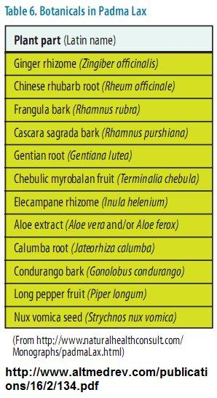
Herbs that help in IBS, UC or CD
Peppermint oil capsules
Artichoke leaf extract
Onion
Curcuma - turmeric
Liqorice
Fenugreek
Cannabis sativa
Ginseng - Panax
Aloe vera gel
Wheat grass juice
Boswellia serrata
Slippery elm
Devil's claw
Tormentil
Wei tong ning [20]
Fufangkushen colon-coated (FCC) capsule
Malva parviflora
Qingchang Shuan
T. purpurea roots
Tormentil extracts
Withania somnifera

Slide 68
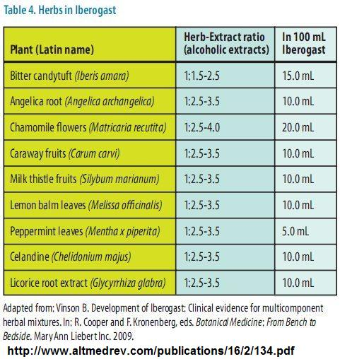

Slide 69
Summary: What to include to reduce IP
Antioxidants and antiinflammatory food /suppl. and vitamins
Nutrients for epithelial cell proliferation and regeneration
Probiotic bacteria
Prebiotics - polysaccharides [fibers, some sugars etc.]
Pathogenic bacteria suppression
Curcumin, neem, garlic, onion,...many other herbs and spices
Blood supply in GIT capillary
Aphrodisiacs
Ginkgo and maybe other nootropics
Parasymphaticomimetics like hemp etc.
Secretagogue of bile salts with PC
Bitter herbs, chlorophyl etc.
PUFAs
Cholecystocinine mimetics
Venous inflammation and edema reduction - rutosides [rutin, aescin, hesperidin,...]

Slide 70
Probably most easy and effective combinations
Mutaflor [only on prescription in CR]
Lactobacilli
Omega-3 MK
Psyllium husk
Green tea
NAC - ACC [mucolytic]
Ginkgo biloba
Curcuma
Rutosides [rutin, hesperidin, aescin,...] [venopharmaca]
Zinc, Vitamin C, E, D, folic acid
N-acetyl-D-glucosamine (NAG), Glutamine, Phosphatidylcholine (PC)
Anti-inflammatory diet as metabolic balance is
low AGEs, no gluten, no milk, no alcohol
rich in phospholipids, glutamine, boost glutathione...

Slide 71
Direct benefits of metabolic balance on IP
Basic fresh food sorts - no unnecessary conservants, adds and heatings
Low animal fat, enough of oils rich on omega-3, not heated - low dietary AGEs
5h pauses -higher AGEs clearance [autophagocytosis]
Lot of water - higher AGEs clearance [urinary excretion]
Low sugars - lower insulin and proinflammatory signals, lower inner AEGs synt.
Eggs [lecithines] as one of the central foods
Lentils - probiotic sugars
Salats aside - folic acid, choloretics, polyphenolic antioxidants etc.
Lot of fibres incl. pectines from apples - prebiotics
Fresh fruits - antioxidants
Easy to avoid gluten or cow milk antigens
No limit on healthy herbs and spices
Jogurts often in plans - lactobacillus,...
Vinegars allowed for food preparation [meat marinades to AEGs reduction, lower GI of sugars]
Last food finish before 21h - melatonin sleep quality - better GIT regeneration
Foods included rich on folates, glutamine, cystein etc.
WHAT DID I FORGOT ?

Slide 72
Sources:
[1] en.wikipedia.org/wiki/Intestinal_permeability
[2] en.wikipedia.org/wiki/FODMAP
[3] https://www.ncbi.nlm.nih.gov/pmc/articles/PMC1856434/
[4] https://www.ncbi.nlm.nih.gov/pmc/articles/PMC1856434/
[5] https://www.ncbi.nlm.nih.gov/pmc/articles/PMC4253991/
[6] http://www.zdravastreva.cz/page/68004.propustne-strevo/
[7] www.wikiskripta.eu/index.php/Laktul%C3%B3zo/mannitolov%C3%BD_test_st%C5%99evn%C3%AD_propustnosti
[8] www.linkos.cz/files/klinicka-onkologie/23/460.pdf
[9] www.ncbi.nlm.nih.gov/pmc/articles/PMC4316216/
[10] https://www.ncbi.nlm.nih.gov/pmc/articles/PMC4253991/
[11] jn.nutrition.org/content/141/5/769.full
[12] www.sciencedirect.com/science/article/pii/S1568997215000245
[13] physrev.physiology.org/content/91/1/151
[14] www.naturalmedicinejournal.com/journal/2010-03/nutritional-protocol-treatment-intestinal-permeability-defects-and-related
[15] www.ncbi.nlm.nih.gov/pmc/articles/PMC3758766/
[16] www.ncbi.nlm.nih.gov/pmc/articles/PMC4637104/
[17] www.ncbi.nlm.nih.gov/pubmed/18074031/
[19] www.ncbi.nlm.nih.gov/pubmed/27798599
[20] draxe.com/4-steps-to-heal-leaky-gut-and-autoimmune-disease/
[21] www.ncbi.nlm.nih.gov/pmc/articles/PMC3966653/
[22] www.ncbi.nlm.nih.gov/pubmed/16879559
[23] www.jsir.gr.jp/journal/Vol31No3/pdf/06_S2_31.pdf
[24]www.mdc-berlin.de/44592828/en/research/research_teams/signal_transduction_in_tumor_cells/Projects/NF-kappaB-in-organogenesis-and-disease/NF-kappaB-signaling-in-intestinal-epithelial-regeneration
[25] https://www.ncbi.nlm.nih.gov/pmc/articles/PMC3704564/
[26] https://www.ncbi.nlm.nih.gov/pmc/articles/PMC3583887/
[27] http://www.internimedicina.cz/pdfs/int/2007/12/02.pdf
[28] http://www.boxingscene.com/nutrition/127.php
[28] http://www.globalhealingcenter.com/natural-health/folic-acid-foods/

Slide 73
Thank You for attention
There is so many things we can do for our our intestine…
...and at the same time most of those things are good for our brain, too.

